Slide 1
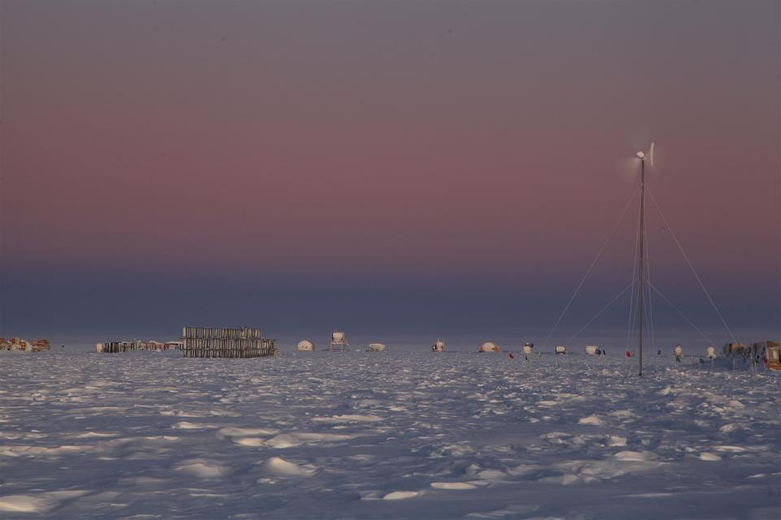
Searching for Quantum Gravity with the
IceCube Neutrino Observatory
John Kelley for the IceCube Collaboration
Wisconsin IceCube Particle Astrophysics Center
University of Wisconsin – Madison, U.S.A.
Experimental Search for Quantum Gravity: the Hard Facts
Perimeter Institute, Waterloo, Ontario
October 23, 2012
photo credit: S. Lidstrom

Slide 2
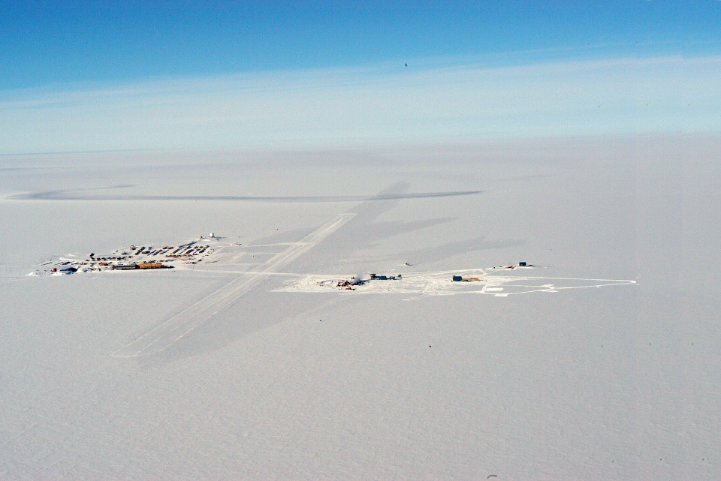
IceCube from the Air
IceCube
South Pole Station
control room
skiway

Slide 3
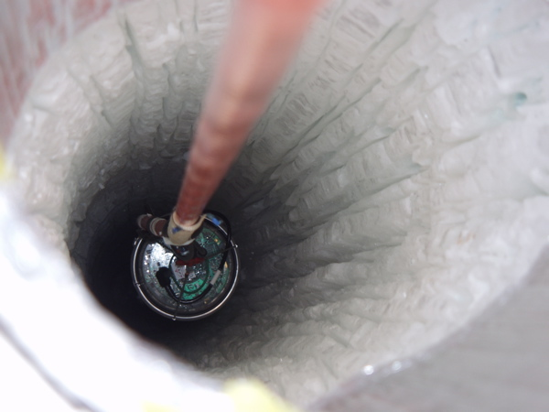
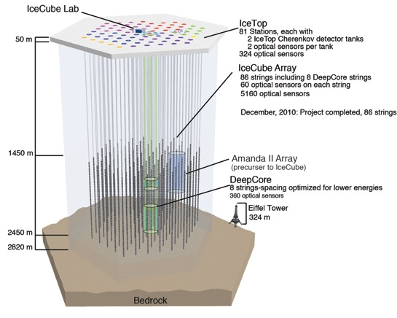
The IceCube Detector
AMANDA-II Array
(precursor to IceCube)
digital optical module (DOM)

Slide 4
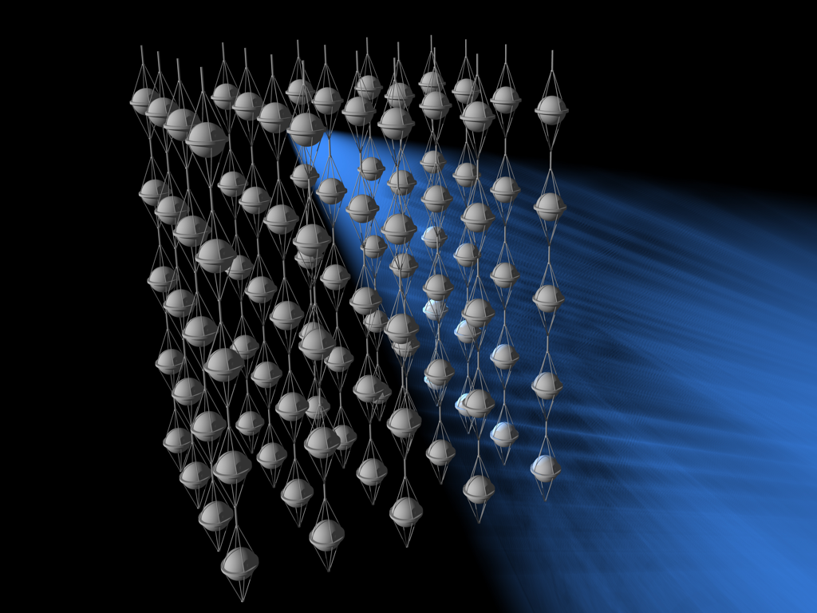
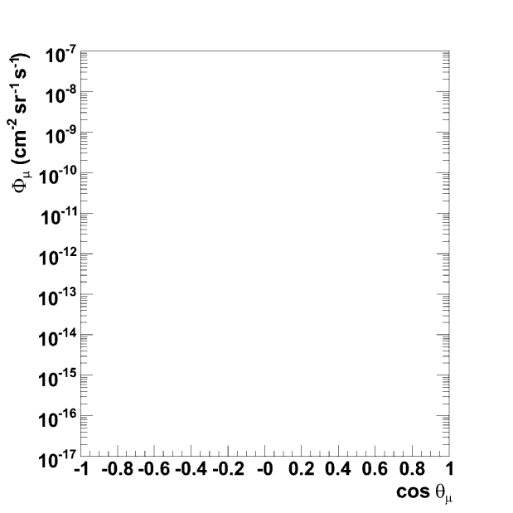
Detection Principle
astrophysical ν
νμ
μ
cosmic ray
Northern Sky
W
N
X
atmos ν
atmospheric µ
ν_{atm}
atmospheric μ
ν-induced µ
cosmic ray
Southern Sky

Slide 5
Event Signatures
Positions, times, and amplitudes of Cherenkov light deposition: neutrino direction + energy
up-going muon: ν_{μ}
cascade → all flavors
Down-going μ
background
& EHE ν
ν_{e}
ν_{e} CC + all flavor NC
μ
Relevant energy ranges:
atmospheric neutrinos: dominant below 100 TeV
“prompt” nu from atmospheric charm: ~300 TeV
cosmic-ray accelerators: > 100 TeV
cosmogenic neutrinos: ~10⁶ TeV
ν_{μ}

Slide 6
Detector Performance
Simulated tracks
Simulated cascades
IC40
E⁻² spectrum
angular resolution: ~1º
energy resolution: ~35%
μ energy estimation via dE/dx
~30% in log₁₀(E)
angular resolution: ~10-30º
Continual time synchronization to ~2 ns; ice calibration with in-situ flashers

Slide 7
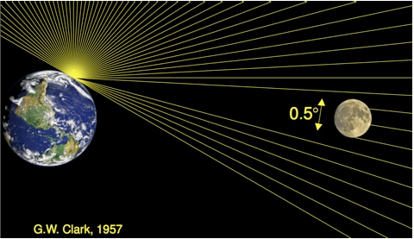
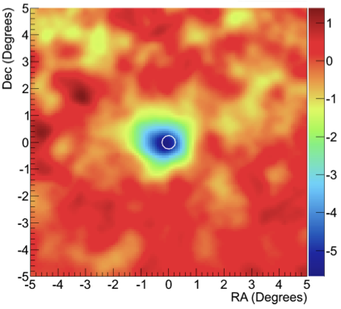
Shadow of the Moon

Slide 8
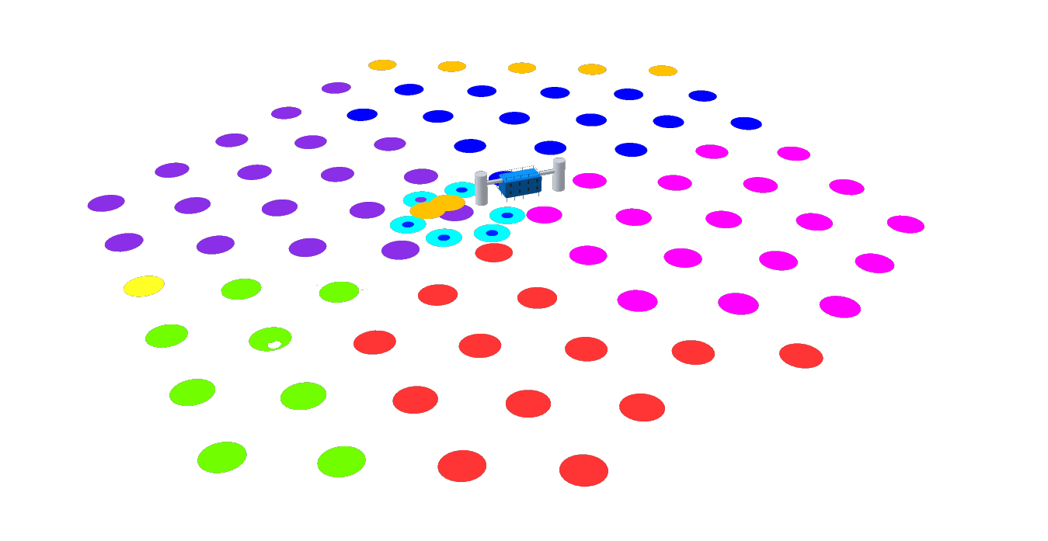
IceCube Configurations
IC-86: 2011–
IC-59
09-10 Season
IC-79
10-11 Season
IC-40
08-09 Season
IC-1
05-06 Season
IC-9
06-07 Season
IC-22
07-08 Season
Construction completed in December 2010
8

Slide 9
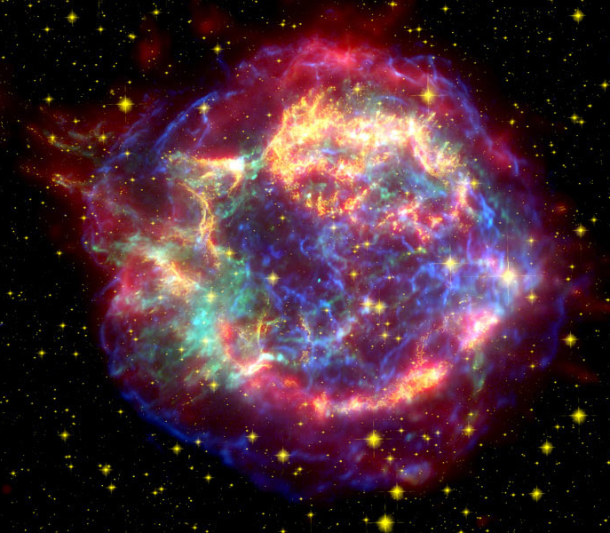
Searches for Quantum Gravity with IceCube
First step: need a neutrino source!
Atmospheric neutrinos (CR+Earth’s atmosphere)
Neutrinos from cosmic ray accelerators (whatever those are)
  static neutrino sources
  transient sources (GRBs?)
UHE neutrinos (CR+CMB)
Supernova remnant Cas A
Possible cosmic ray / neutrino source?
Spitzer / Hubble / Chandra image

Slide 10
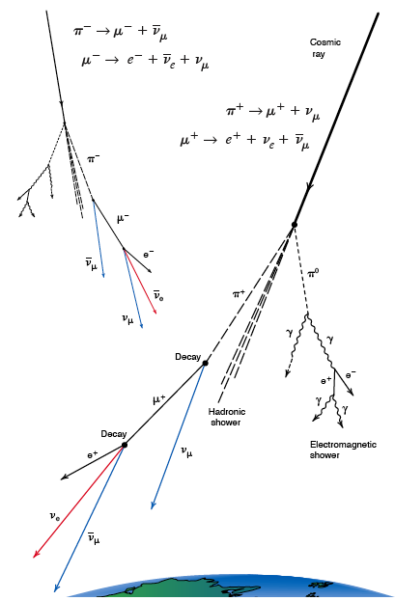
Atmospheric Neutrinos
Cosmic rays produce muons, neutrinos through charged pion / kaon decay
Even with > km overburden, atm. muon events dominate over ν by ~10⁶
Muon neutrino CC events: reconstruct direction + use Earth as filter
Figure from Los Alamos Science 25 (1997)

Slide 11
Atmospheric Neutrino Spectra
~4 atm. neutrinos / day
  in AMANDA-II
~200 atm. neutrinos / day
  in IceCube
neutrino point sources?
diffuse high-energy flux?
cosmogenic neutrinos?

Slide 12
Possible QG Signatures
Our neutrino sample is (mostly) above the atmospheric oscillation regime (>100 GeV)
Unexpected flavor transitions could indicate:
  Lorentz-violation-induced oscillations
  quantum decoherence
atmos ν_{μ}
atmos ν_{τ,e}
ν_{atm}

Slide 13


Quantum Decoherence
Another possible low-energy signature of quantum gravity: decoherence
Heuristic picture: foamy structure of space-time (interactions with virtual black holes) may not preserve certain quantum numbers (like ν flavor)
  Pure states interact with environment and decohere to mixed states
Formalism: will skip basically everything, but start by modifying the density matrix propagation:
see e.g. Morgan et al., astro-ph/0412628

Slide 14
Decoherence + Atmospheric Oscillations
characteristic exponential behavior
1:1:1 ratio after decoherence
derived from Barenboim, Mavromatos et al. (hep-ph/0603028)
Energy dependence depends on phenomenology:
n = -1
preserves
Lorentz
invariance
n = 1
???
n = 2
recoiling
D-branes*
n = 3
Planck-suppressed
operators‡
*Ellis et al., hep-th/9704169
‡ Anchordoqui et al., hep-ph/0506168

Slide 15
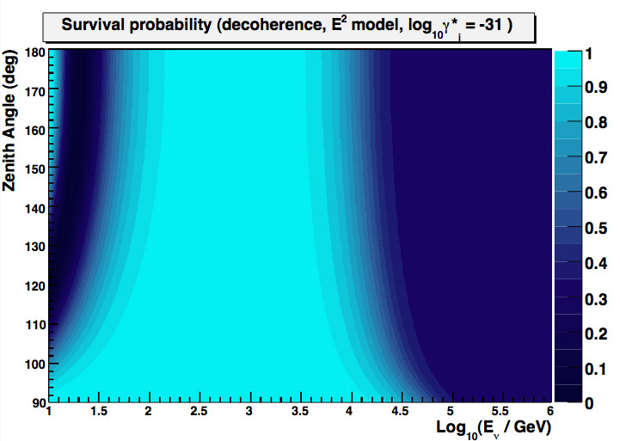
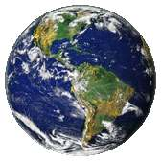
QD Atmospheric ν_{μ} Survival Probability
p=1/3

Slide 16
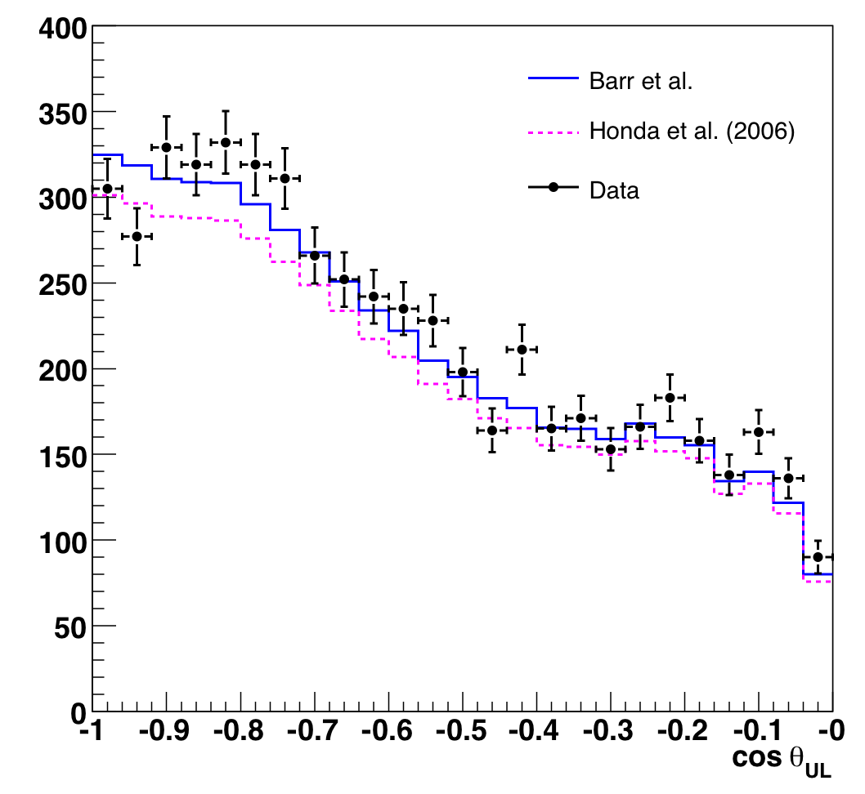
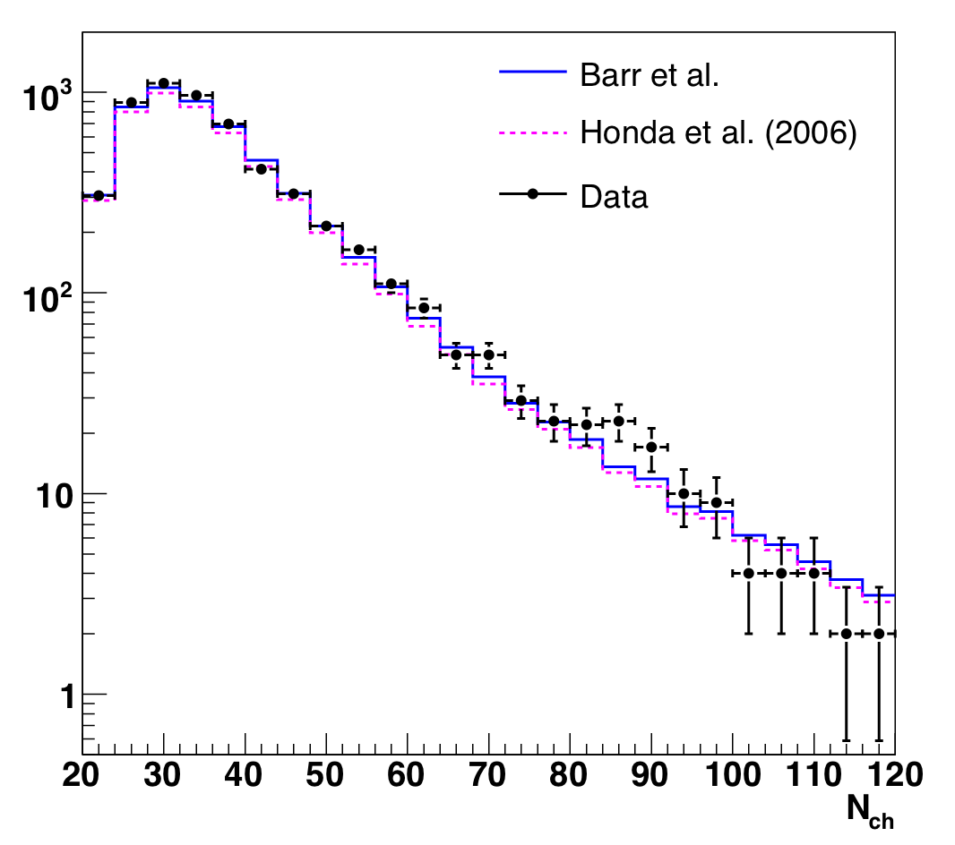
AMANDA 2000-2006 Atmospheric ν_{μ}
zenith angle
number of modules hit
(energy proxy)
Data consistent with SM atmospheric neutrinos + O(1%) background

Slide 17
Results: Limit on Quantum Decoherence
E² model
SuperK limit‡ (2-flavor):
γ_{i} < 0.9 × 10⁻²⁷ GeV⁻¹ (90% CL)
This analysis:
D*_{i} < 1.3 × 10⁻³¹ GeV⁻¹ (90% CL)
QG expectation? d* of O(1) where
Limit for n=2: d* < 1.6 × 10⁻¹²
excluded
‡ Lisi, Marrone, and Montanino, PRL 85 6 (2000)
Abbasi et al., PRD 79, 102005 (2009)
best fit
Similar methods can be used to set limits on violation of Lorentz invariance

Slide 18
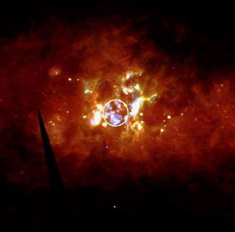
Other Possibilities
Astrophysical neutrino sources would provide even more powerful probes of QG
  Electron antineutrino decoherence from, say, Cygnus OB2
  (see Anchordoqui et al., hep-ph/0506168)
  But “standard” sources: degeneracy with 1:1:1 flavor ratio from standard oscillations
  Distortions in high-energy neutrino spectra?
  Time delays from GRBs?
Cygnus OB2 region
courtesy of J. Knoedlseder

Slide 19
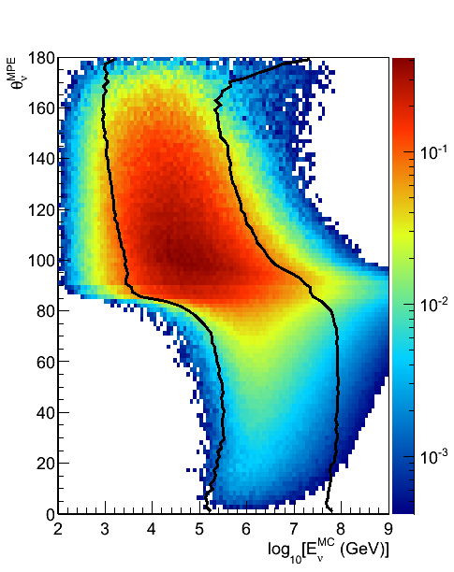
Neutrino Point Source Searches
δ
σ
r.a.
Unbinned likelihood search to search
for time-independent clustering
Covers both hemispheres
(different backgrounds, energy regimes)

Slide 20
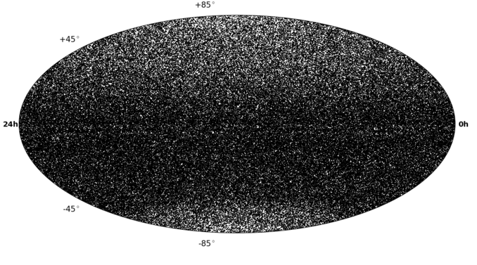
IC79+IC59+IC40 Neutrino Sky
Atm. neutrinos
Total events (IC40+IC59+IC79): 108317 (upgoing) + 146018 (downgoing)
Livetime: 316 days (IC79) + 348 days (IC59) + 375 days (IC40)
Atm. muons
?

Slide 21
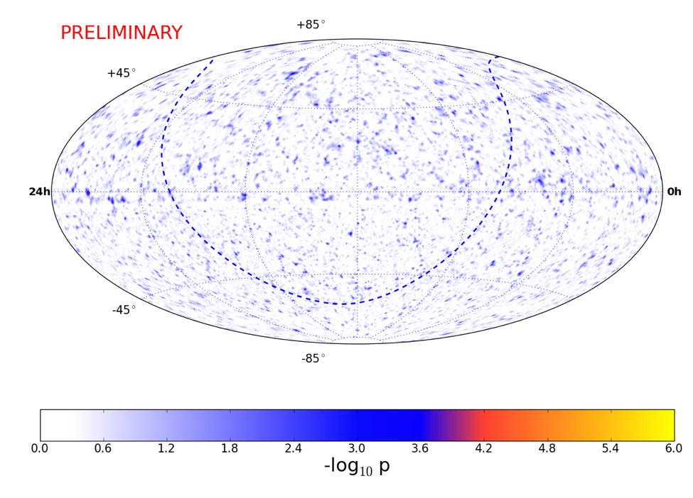
IC79+IC59+IC40 Neutrino Sky
Atm. neutrinos
Total events (IC40+IC59+IC79): 108317 (upgoing) + 146018 (downgoing)
Livetime: 316 days (IC79) + 348 days (IC59) + 375 days (IC40)
Atm. muons
?

Slide 22
IC79+IC59+IC40 Neutrino Sky
Atm. neutrinos
Total events (IC40+IC59+IC79): 108317 (upgoing) + 146018 (downgoing)
Livetime: 316 days (IC79) + 348 days (IC59) + 375 days (IC40)
-log10(p) = 4.707
Ra: 34.25 Dec: 2.75
nSrcbest: 23.07
γbest: 2.35
Atm. muons
-log10(p) = 4.047
Ra: 219.25 Dec: -38.75
nSrcbest: 20.81
γbest: 3.75
?

Slide 23
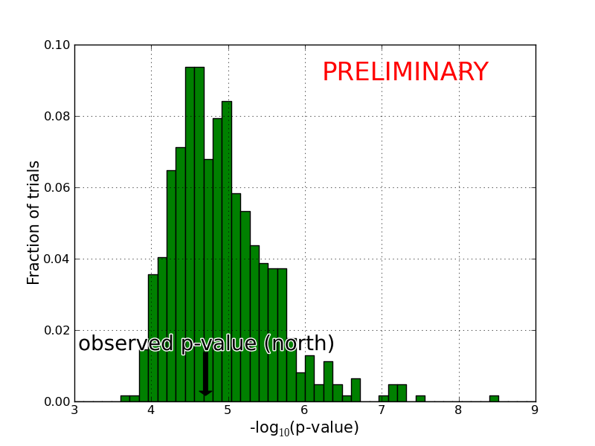
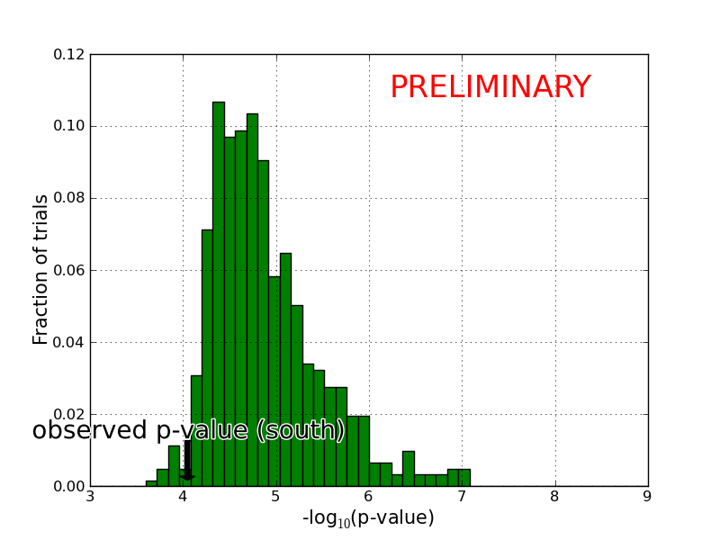
IC79+IC59+IC40 Neutrino Sky
Atm. neutrinos
Total events (IC40+IC59+IC79): 108317 (upgoing) + 146018 (downgoing)
Livetime: 316 days (IC79) + 348 days (IC59) + 375 days (IC40)
56.8%
-log10(p) = 4.707
Ra: 34.25 Dec: 2.75
nSrcbest: 23.07
γbest: 2.35
Atm. muons
-log10(p) = 4.047
Ra: 219.25 Dec: -38.75
nSrcbest: 20.81
γbest: 3.75
97.9%
?

Slide 24
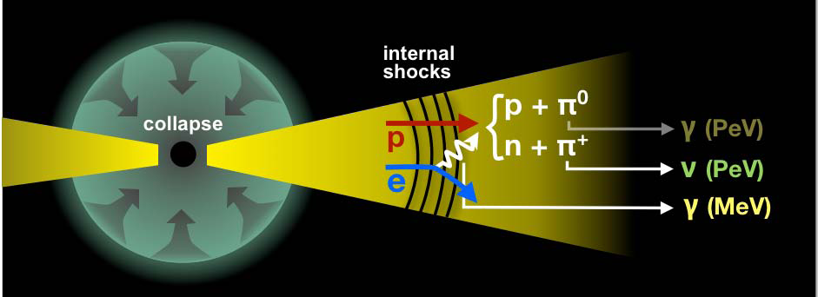
Gamma-ray Burst Neutrinos
“Long” GRBs (~10s) are likely associated with core-collapse supernovae
“Fireball” phenomenological model of GRBs predicts gamma-ray and neutrino emission from proton acceleration
  normalized by high-energy cosmic ray spectrum if GRBs are the accelerators

Slide 25
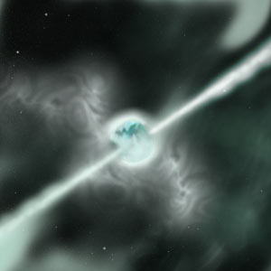
GRB Neutrinos as a Probe of QG
Lorentz violation, dispersion of:
time delay / advance of
GRB neutrinos: large d and high E!
Δt_{source}
Δt_{LIV}
Benefits: possibly larger distances, higher energies with neutrinos than photons
Challenges: source physics (intrinsic delays up to O(1000) seconds) and energy measurement
Other challenge: have to detect the neutrinos first!
  U. Jacob and T. Piran, Nature Phys. 3, 87 (2007)
  M.C. Gonzalez-Garcia and F. Halzen, JCAP 0702, 008 (2007)
  G. Amelino-Camelia and L. Smolin, Phys. Rev. D 80, 084017 (2009)

Slide 26
GRB Searches
T_{0:} From a satellite GCN
Off-time
On-time
Off-time
Precursor (~100 s)
Prompt (T₉₀)
Model Independent (±24 h)
Off-time (full year)
Very low background:
One event can be significant
Two stacked searches using
IC40 and IC59 data (300 GRBs)
IC-59
98 northern GRBs

Slide 27
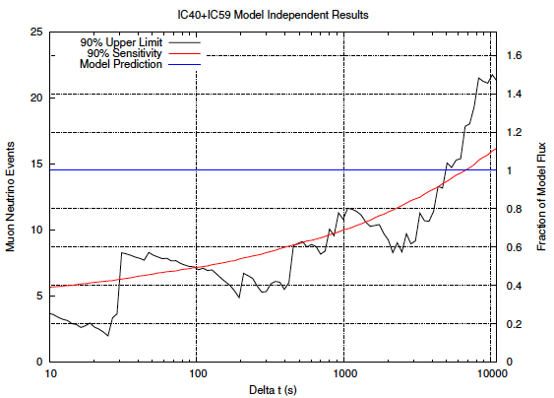
IC40 + IC59 GRB Results
No observation of GRB neutrinos:
“fireball” theory must be significantly revised
hypothesis of GRBs as the primary source of UHECRs excluded for some models
14 events expected (Guetta et al.)
0 neutrino events observed
(2 background)
Nature Vol 484, 351 (2012)

Slide 28
Untriggered Flare Searches
Would we have seen a GRB with larger QG effects? Maybe, if bright enough...
40-string IceCube data
flare search
Hottest spot:
(RA,Dec)=(254.75º, +36.25º)
15 second time period
56% post-trial significance
Astrophys.J. 744, 1 (2012)
For greater sensitivity: stacking analysis incorporating a
distance- and energy-dependent delay hypothesis

Slide 29
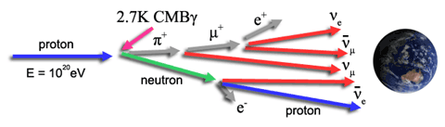

Ultra-high Energy Neutrino Searches
image courtesy JEM-EUSO
VLI-induced neutrino splitting
  modification of spectral shape
  see e.g. Mattingly, Liberati et al., arXiv: 0911.0521
Cross section enhancement from large extra dimensions
  detection via angular dependence of event rate
  see e.g. Connolly, Thorne, and Waters, arXiv:1102.0691

Slide 30

GZK Effect
Cosmic ray energy spectrum
Suppression (“cutoff”) of high-energy cosmic rays due to interaction with CMB photons (Greisen-Zatsepin-Kuzmin)
Threshold ~ 6 × 10¹⁹ eV
Suppression observed in cosmic-ray flux consistent with GZK explanation
  Auger Collaboration,
  Phys. Lett. B685 (2010) 239

Slide 31

The Neutrino Connection
GZK process also produces UHE neutrinos!
Nuclei will tend to photodisintegrate first (reduced flux)
Neutrino measurement could confirm GZK nature of CR suppression
GZK neutrino flux models
best-fit proton
range of iron
Anchordoqui et al., PRD 76 123008 (2007)

Slide 32
IceCube EHE Neutrino Search
PRELIMINARY
May 2010 – May 2012 (672.7 days livetime)
Primary selection criterion: high “NPE”
Track reconstruction quality removes corner-clippers, coincident CR events
see also first IceCube upper limits: Phys. Rev. D 82, 072003 (2010)

Slide 33
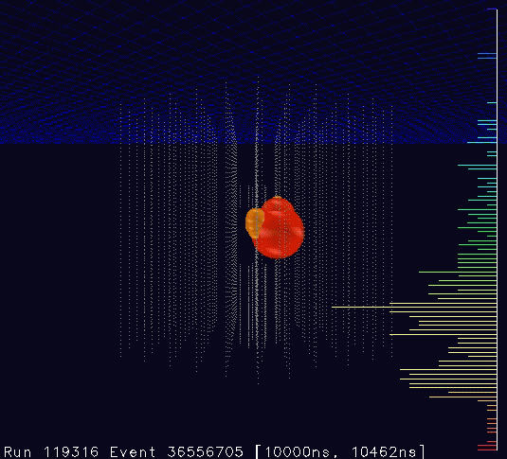
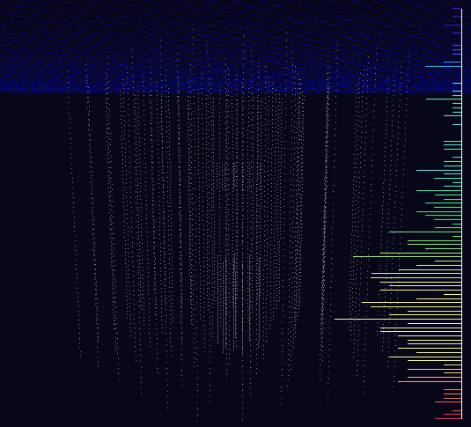
Neutrino Candidates
Two cascade events in unblinded data sample (background estimation: 0.14 events; 2.36σ)
9 Aug. 2011: 70k PE, 354 DOMs
3 Jan 2012: 96k PE, 312 DOMs
“Bert” ~1100 TeV
“Ernie” ~1300 TeV
PRELIMINARY

Slide 34
Event Brightness
No indication that they are background cosmic-ray muons
Analysis of energy, directions ongoing
Follow-up analysis in progress
  extend to lower energies
  veto downgoing atmospheric neutrinos
  all flavors

Slide 35
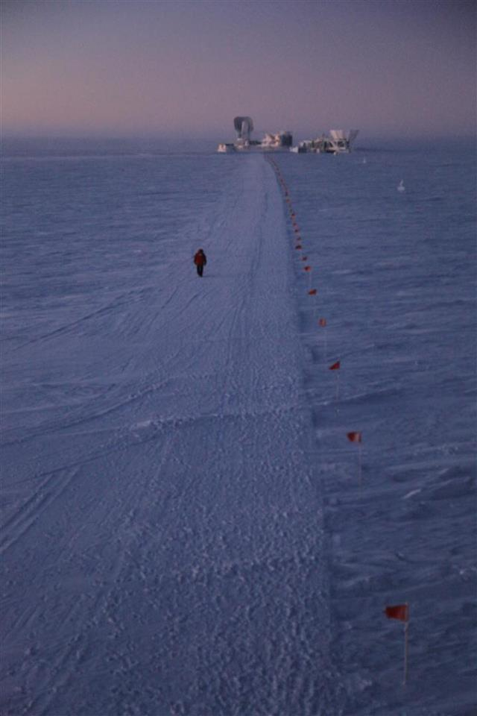
Conclusions and outlook
IceCube is completed and is operating well
Atmospheric neutrinos: our high-statistics source
  limits on quantum decoherence in neutrino sector
  limits on violation of Lorentz invariance
Extend searches to higher energies, longer baselines
  no GRB neutrinos seen so far; GRB models constrained
  ongoing searches for other neutrino point sources
High-energy searches for diffuse and cosmogenic neutrinos
  no significant excess so far, but two interesting events
  may eventually provide the next “test beam”
photo credit: S. Lidstrom

Slide 36
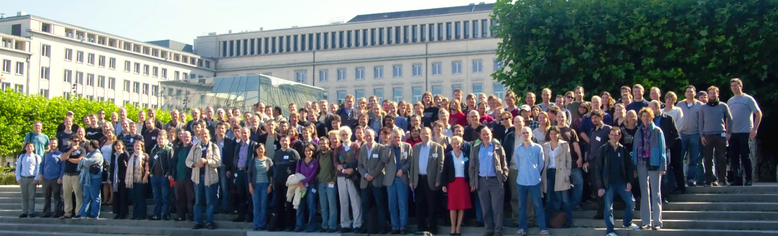



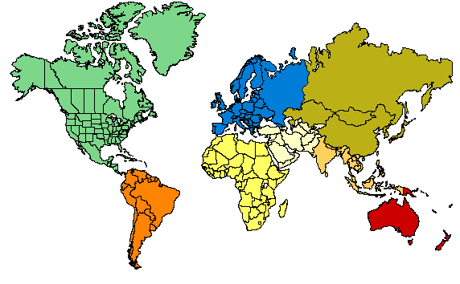






ICECUBE
COLLABORATION
10 countries, 40 institutions, ~260 collaborators
Universität Mainz, Germany
DESY Zeuthen, Germany
Universität Wuppertal, Germany
Universität Dortmund, Germany
Humboldt Universität, Germany
RWTH Aachen, Germany
Universität Bonn, Germany
Ruhr-Universität, Bochum, Germany
MPI, Heidelberg, Germany
Uppsala Universitet, Sweden
Stockholm Universitet, Sweden
Imperial College, London, UK
University of Oxford, UK
Université Libre de Bruxelles, Belgium
Vrije Universiteit Brussel, Belgium
Université de Mons, Belgium
Universiteit Gent, Belgium
EPFL, UniGe, Switzerland
Bartol Research Inst, Univ of Delaware, USA
University of Alaska Anchorage, USA
Pennsylvania State University, USA
University of Wisconsin-Madison, USA
University of Wisconsin-River Falls, USA
LBNL, Berkeley, USA
UC Berkeley, USA
UC Irvine, USA
Stony Brook University, USA
University of Alberta, Canada
Univ. of Alabama, USA
Clark-Atlanta University, USA
Georgia Tech
Ohio State University
Univ. of Maryland, USA
University of Kansas, USA
Southern Univ. and A&M College,
Baton Rouge, LA, USA
Chiba University, Japan
University of the West Indies, Barbados
University of Canterbury,
Christchurch, New Zealand

Slide 37
Backup Slides

Slide 38

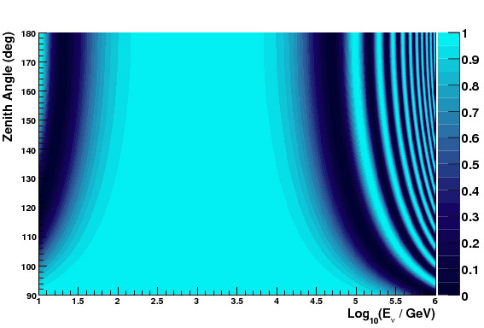
Violation of Lorentz Invariance (VLI)
Different limiting velocity eigenstates: VLI oscilations*
VLI atmospheric ν_{μ} survival probability
maximal mixing, δc/c = 10⁻²⁷
*see González-García, Halzen, and Maltoni, hep-ph/0502223

Slide 39
Results: VLI upper limit
Abbasi et al., PRD 79, 102005 (2009)
maximal mixing
SuperK+K2K limit* (red dotted):
δc/c < 1.9 × 10⁻²⁷ (90%CL)
AMANDA 2000-2006 data:
δc/c < 2.8 × 10⁻²⁷ (90%CL)
IceCube 10-year sensitivity ~ 10⁻²⁸
(yellow dotted)
Cosmic ray limits (on p,π)§: ~10⁻²³
excluded
90%, 95%, 99% allowed CL
*González-García & Maltoni, PRD 70 033010 (2004)
§Scully & Stecker, Astropart. Phys. 31 (2009) 220

Slide 40
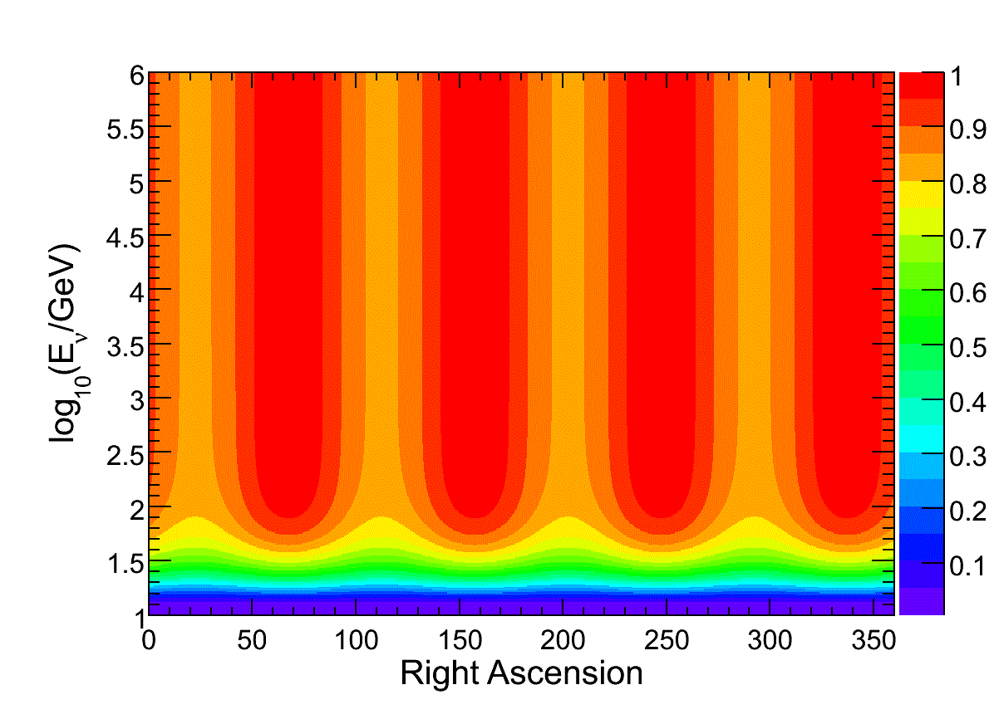
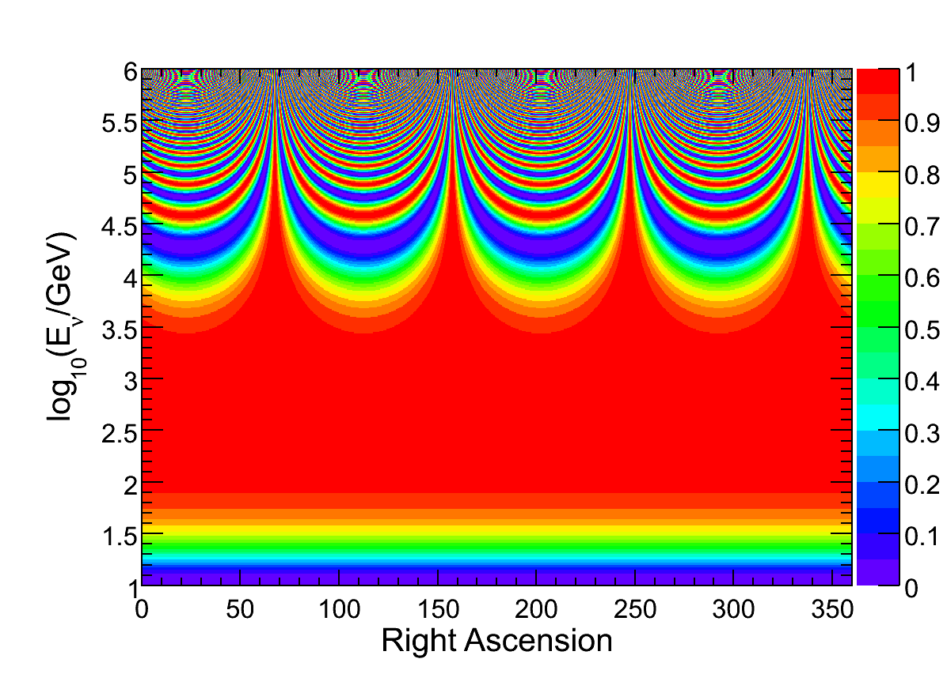
Direction-dependent VLI Oscillations
Survival probability
Standard Model Extension includes interaction coefficients that violate rotational invariance
“Vector Model”:
energy-independent directional VLI, a_{L}
+ energy-dependent directional VLI, c_{L}
Kostelecky and Mewes, PRD 70, 076002

Slide 41
IceCube Direction-dependent VLI limits
Right ascension distribution consistent with atmospheric neutrino expectation
Set upper limits on VLI coefficients based on power in Fourier modes
For energy-dependent effects:
results 3-4 orders of magnitude improved over MINOS
IC40 atmospheric muon neutrino RA
Phys. Rev. D 82, 112003 (2010)
32 bins in RA (using zenith 97 to 120 degrees)

Slide 42
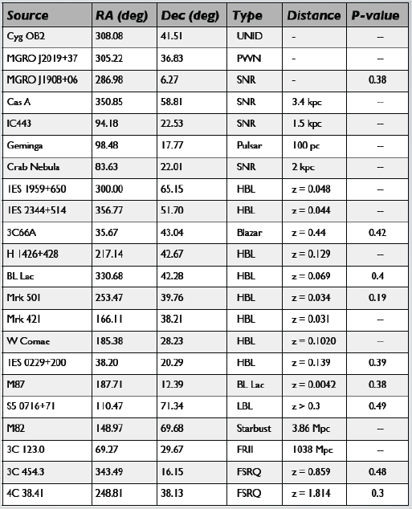
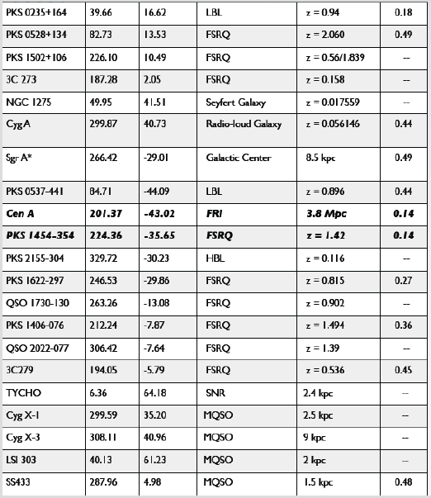
IceCube Selected Sources (IC40+IC59)
13 Galactic (SNR, etc)
30 Extragalactic (AGN, etc)
No significant detections at this point: 95.7 % post-trials p-value

Slide 43
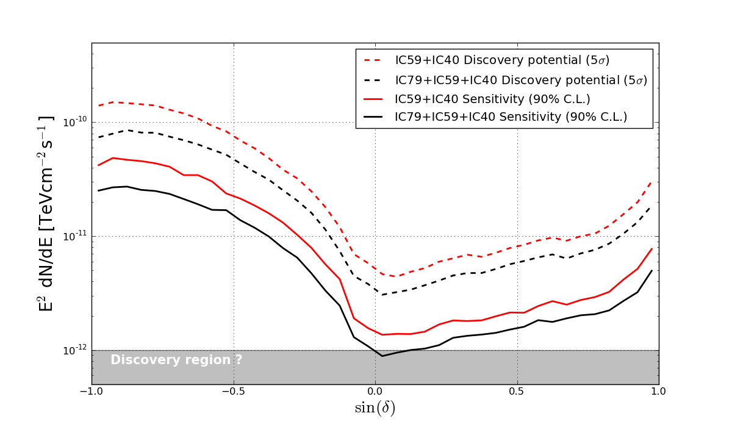
IC79 Point Source Sensitivity

Slide 44
GRB Model Flavors

