Slide 1
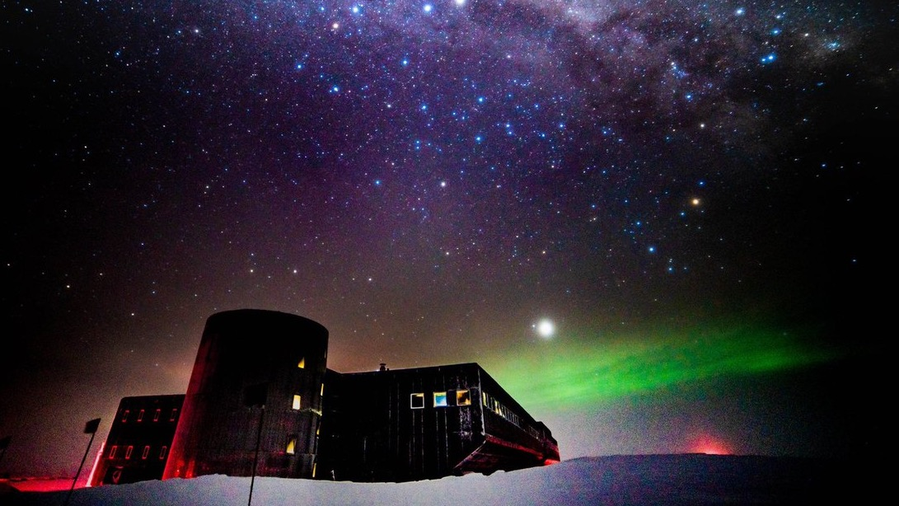
Chasing the ghost particle
Brian Clark
Michigan state university
Making space for all
June 4, 2020

Slide 2
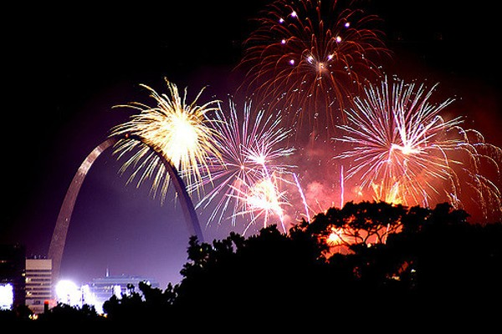
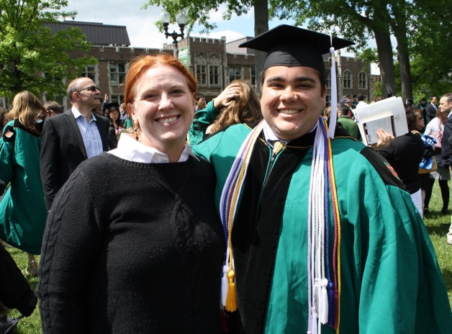
About Me
Original plan was to be a lawyer…
…Now I build telescopes in Antarctica!
Originally from St. Louis, MO.
Graduated in 2014 from WUSTL.

Slide 3
What is a neutrino, and why should you care?
A light, weakly interacting, neutral sub-atomic particle
[Brian’s high school understanding of matter]

Slide 4
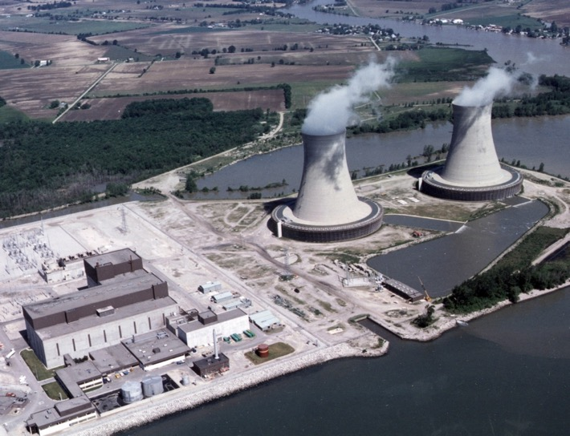
Critical in any nuclear reaction
Radioactive decay (potassium) in bananas
Enrico Fermi Nuclear Plant, Newport MI
Fission in Nuclear Reactors
Fusion Inside stars

Slide 5
Abundant, Light, AND WEAKLY INTERACTING
IC: LUX Science

Slide 6
EXTREMELY LIGHT
<
10,000,000,000

Slide 7
Neutrino oscillations
…and they oscillate from one flavor to another!
Neutrinos come in 3 “flavors”…
This was totally shocking! No other particle changes identity over time

Slide 8
Neutrnios: useful and annoying
Neutral and Weakly Interacting
The Good
Point in straight line
Arrive from far away
Escape dense environments
The Bad
There’s no way to stop a neutrino and study it!
A neutrino from the sun can travel through 6 trillion miles of lead and not stop
“The Ghost Particle”

Slide 9
1956: Discovery of neutrinos
Step 1: (Anti-)neutrino interacts with proton in water to make neutrons
Step 2: Neutron is captured by Cadmium in the water, and makes light
Step 3: Detect the light!
“Project Poltergeist” Hanford, WA in 1953
Use nuclear reactor as neutrino source!

Slide 10
~1970: The solar neutrino problem
John Bahcall: “the sun should make electron neutrinos”
Ray Davis: ”I only measure 1/3 of your prediction!”
100,000 gallons of dry-cleaning fluid in the Homestake Gold Mine, sensitive to electron neutrinos
Only measured 1/3 of the prediction
Where did the rest go? They oscillated!

Slide 11
DREAM FOR ME: See The UNIVERSE through neutrino eyes

Slide 12
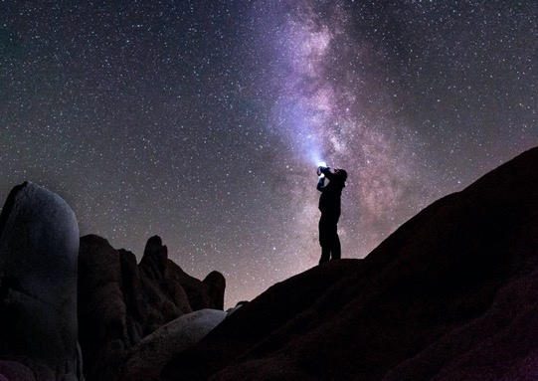
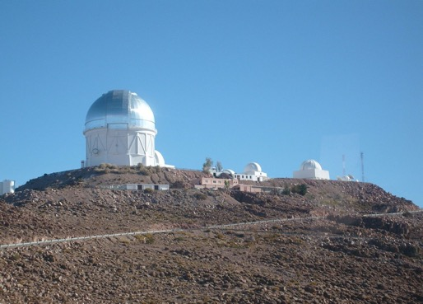
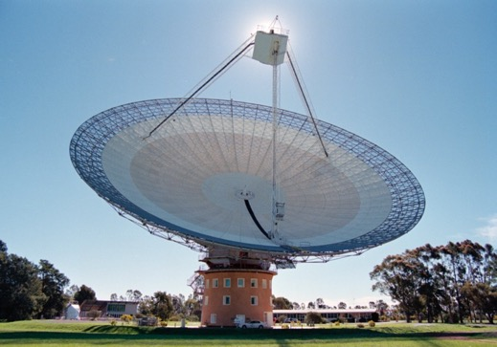
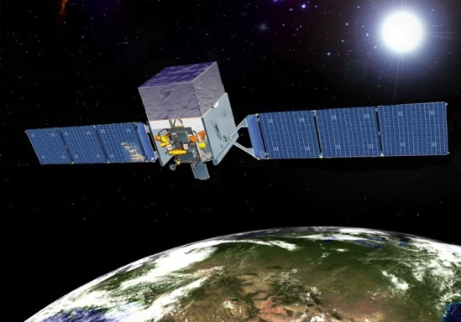
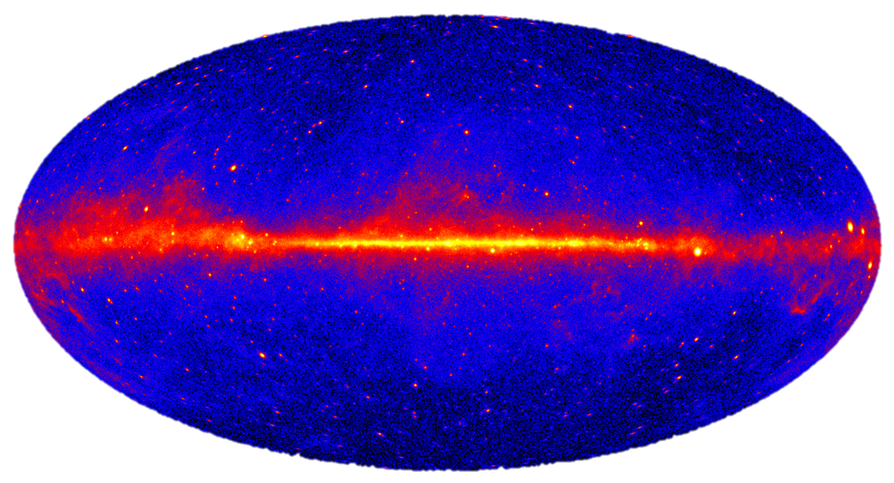
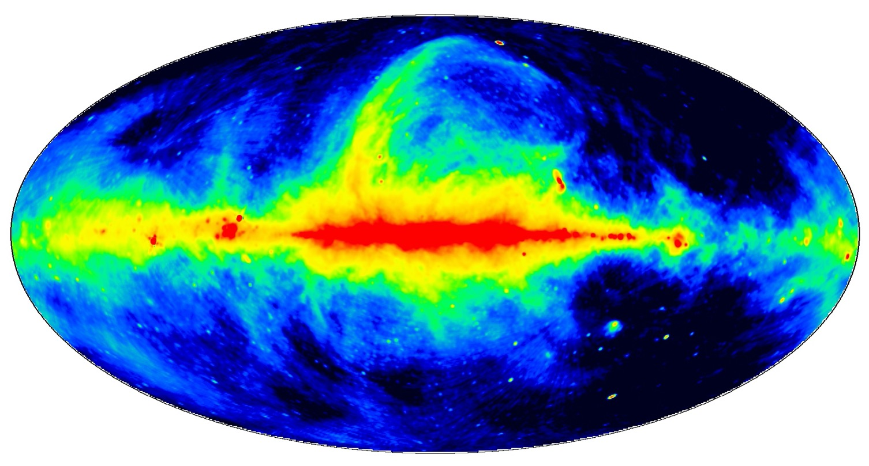
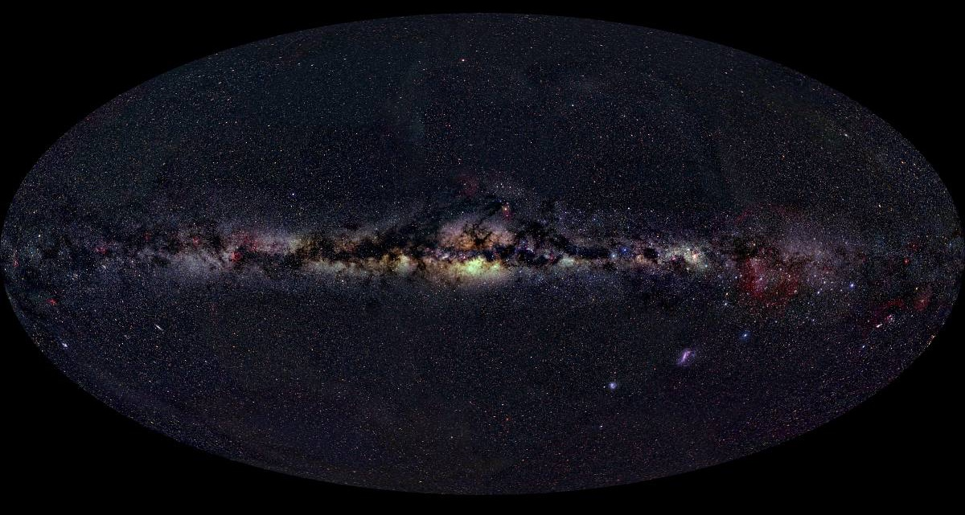
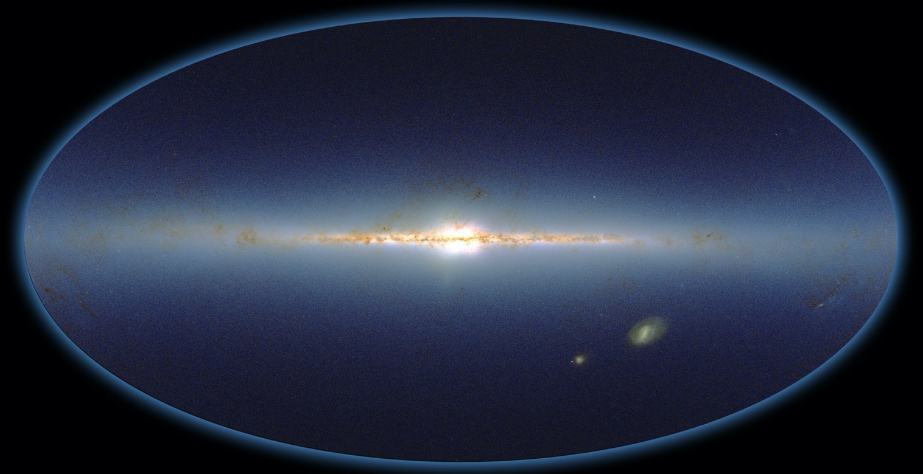
The night SKY
Parkes Radio Telescope
403 MHz
Astrophotographers
Visible
Fermi Telescope
Gamma Rays
2MASS
Infrared

Slide 13
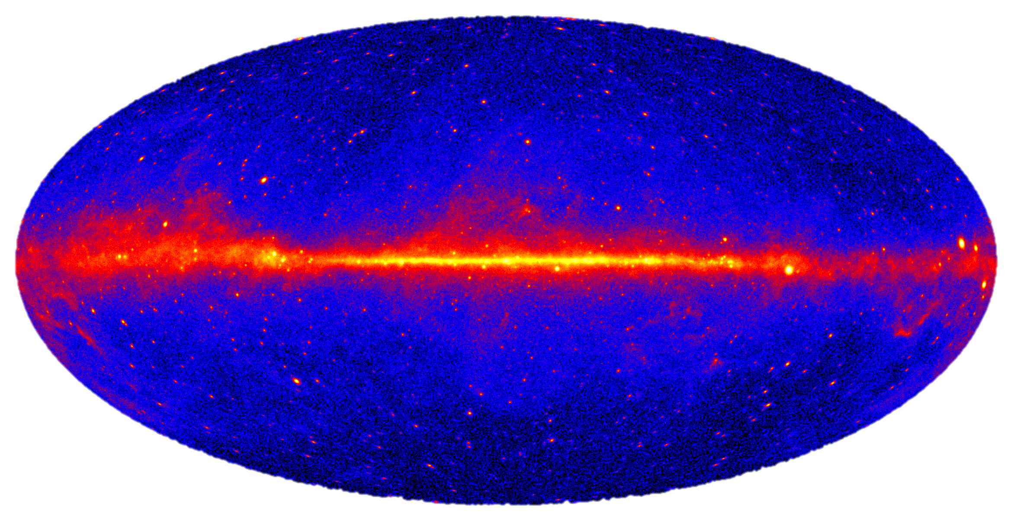
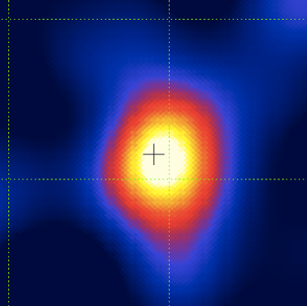
Photo Credit: NASA Fermi Satellite
Crab Pulsar (HAWC)

Slide 14
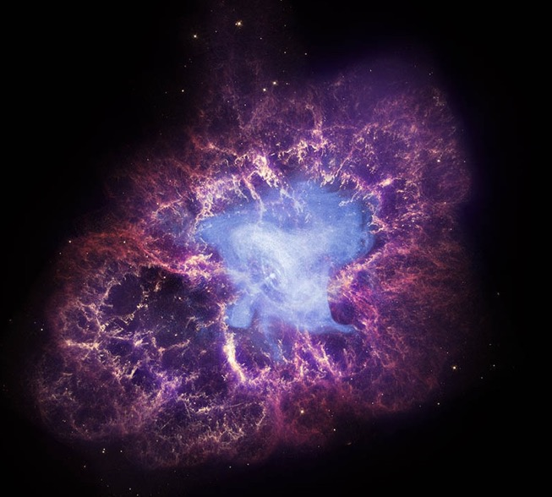
Photo Credit: NASA Fermi Satellite
X-Ray (Chandra)
Optical (Palomar)
IR (2MASS)
Radio (VLA)
In neutrinos?
Gamma Rays (HAWC)

Slide 15
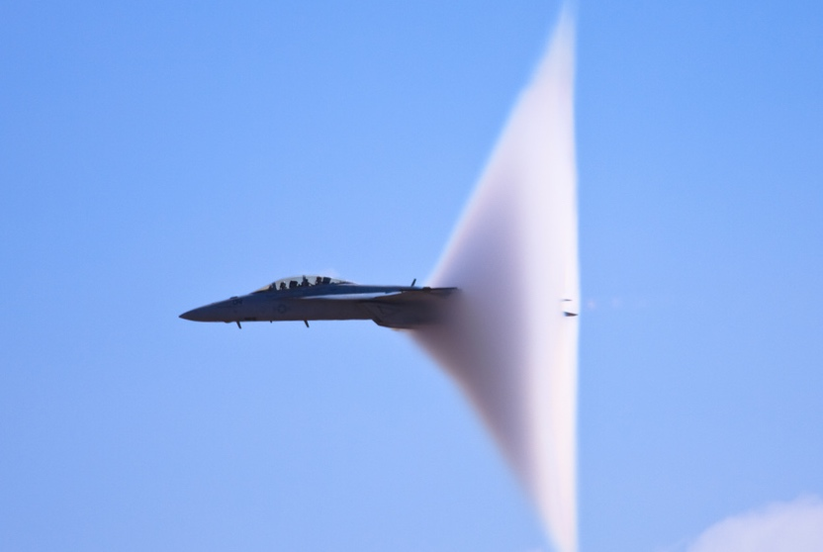
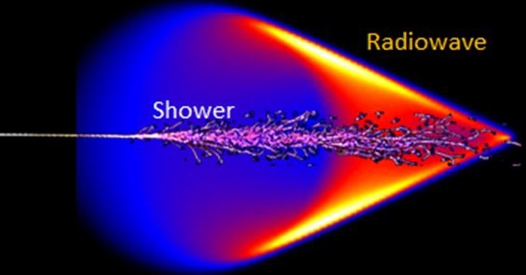
What does a neutrino interaction look like?
F-18 going Supersonic
$$ν$$
Sonic boom…
…puff of blue light + puff of radio waves!

Slide 16
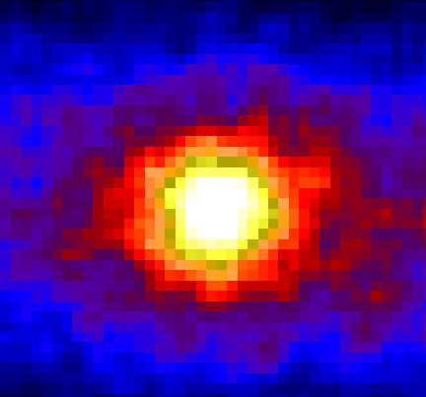
WHAT CAN THEY TEACH US?
How do the insides of stars work?
How do black holes swallowing stars accelerate particles?
The Sun
The Sun in Neutrinos

Slide 17
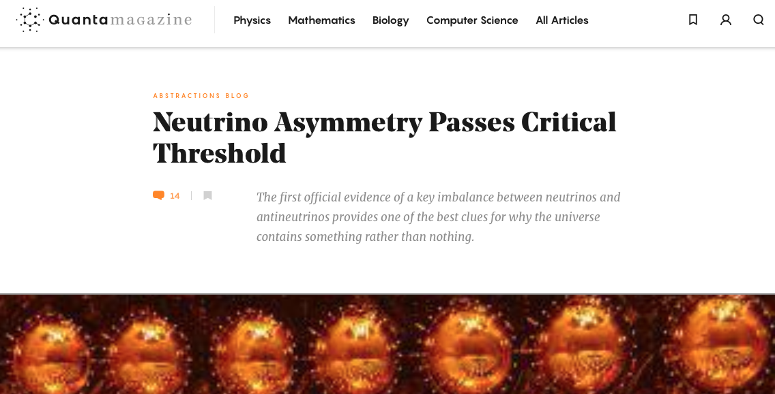
WHAT DO THEY TEACH US?
Why is the universe made of matter and not antimatter?
How are atoms assembled, and how do they decay?

Slide 18
Need an enormous detector
The higher the neutrino energy, the bigger the detector needs to be
A neutrino from the sun can travel through 6 trillion miles of lead and not stop

Slide 19
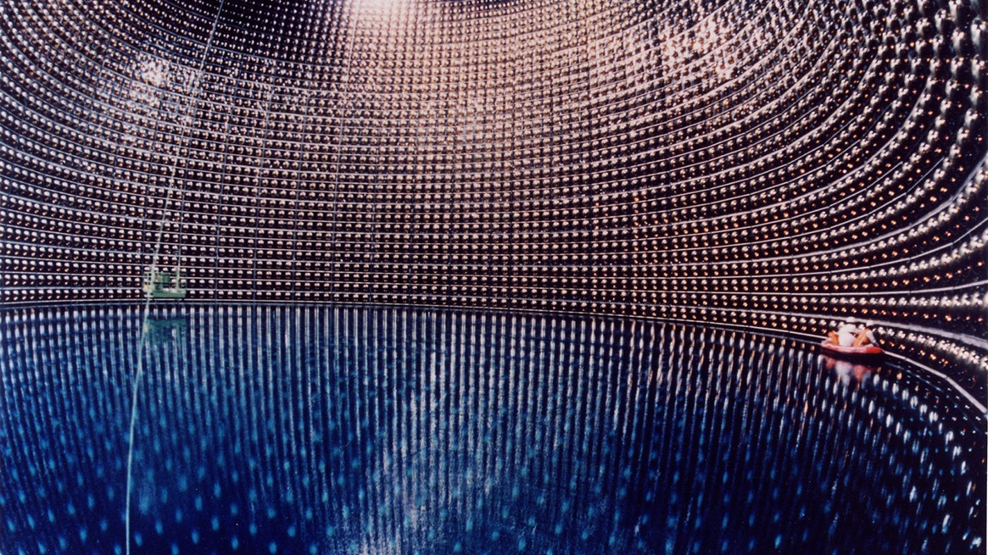
Super-K

Slide 20
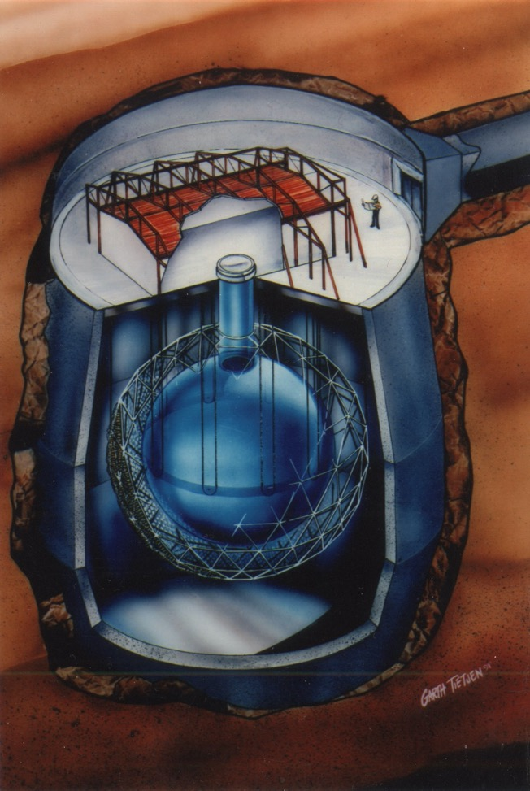
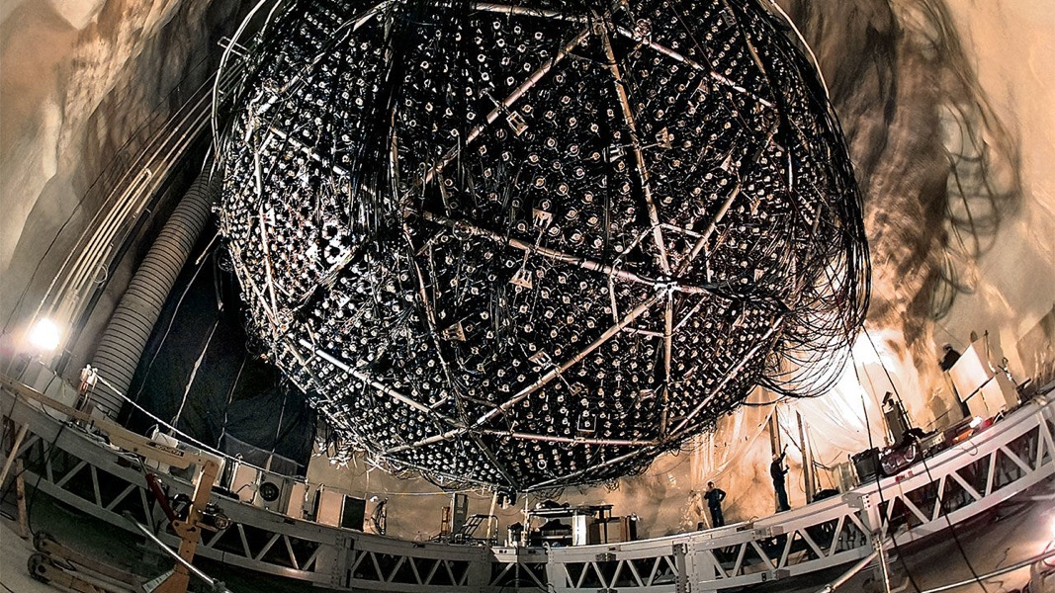
SNO-Lab

Slide 21
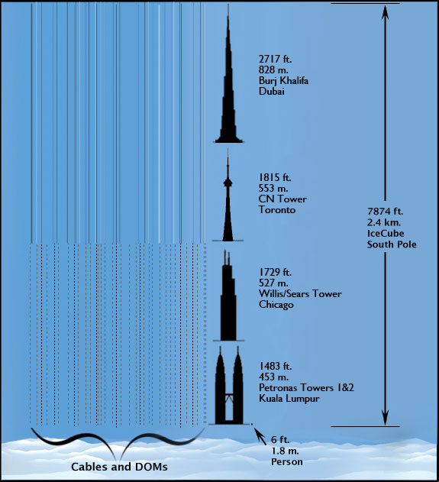
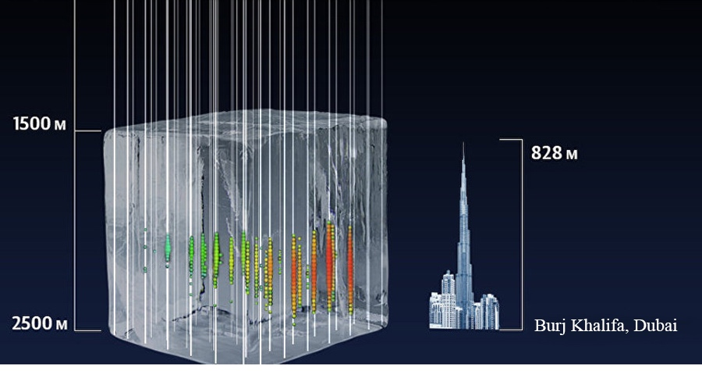
IceCUBE

Slide 22
The IceCube Detector: the world’s biggest “neutrino camera”
Notes:
Just to demonstrate that they exist and show how big they are

Slide 23
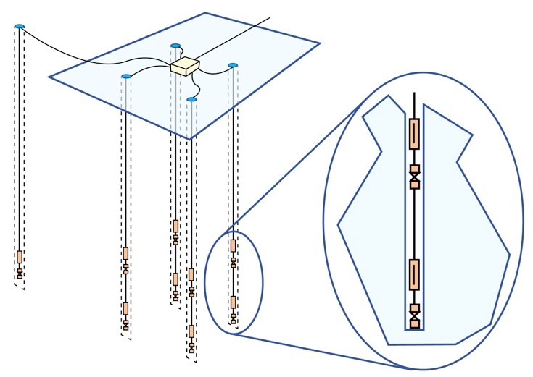
ASKARYAN RADIO ARRAY
Air
Ice
Antennas
Station
$$ν$$
Radio Emission
Detection Concept
Station Design
Antennas in 200m depth holes.

Slide 24
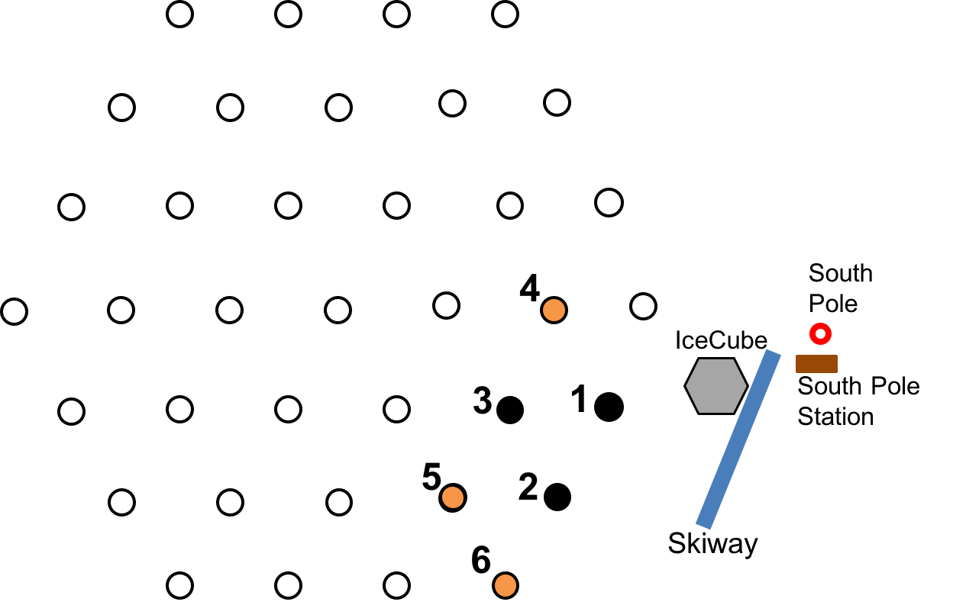
Status of ARA
Deployed ARA Station
4
Instrumentation deployment in 17 / 18.
South Pole
IceCube
Planned ARA Station
3
1
South Pole Station
5
2
2 km
Skiway
6

Slide 25
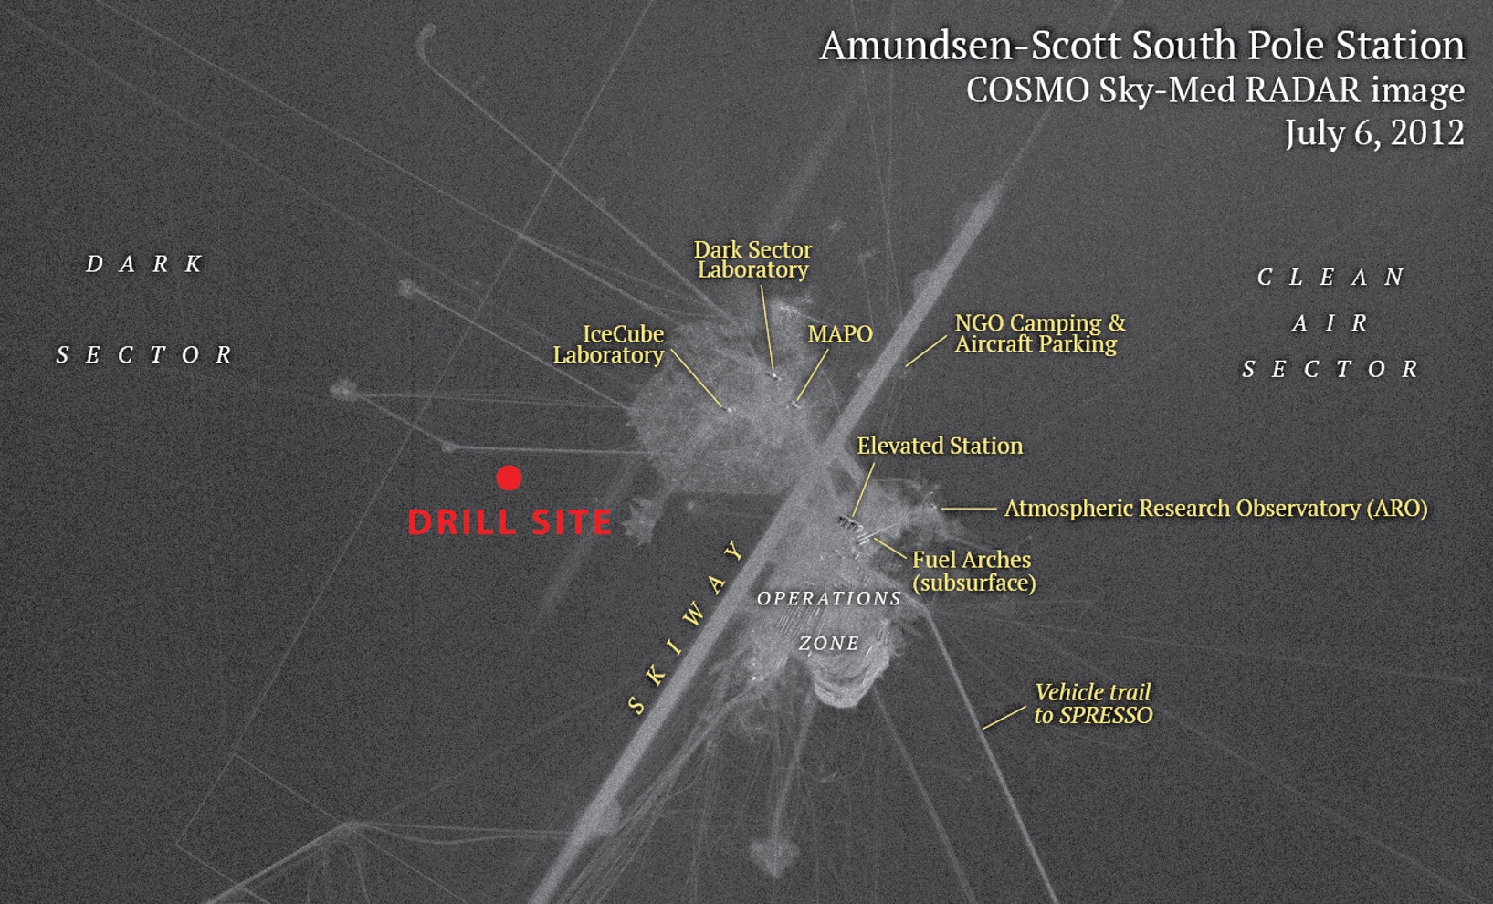
Testbed
ARA1

Slide 26
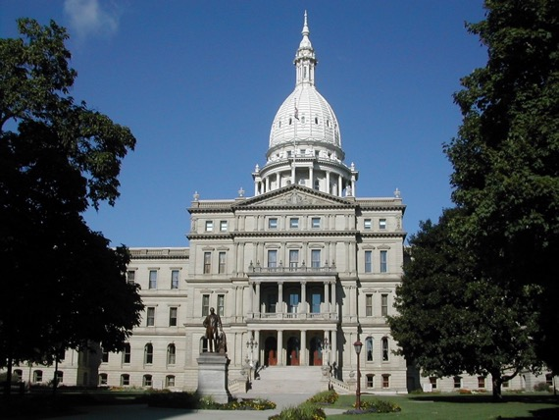
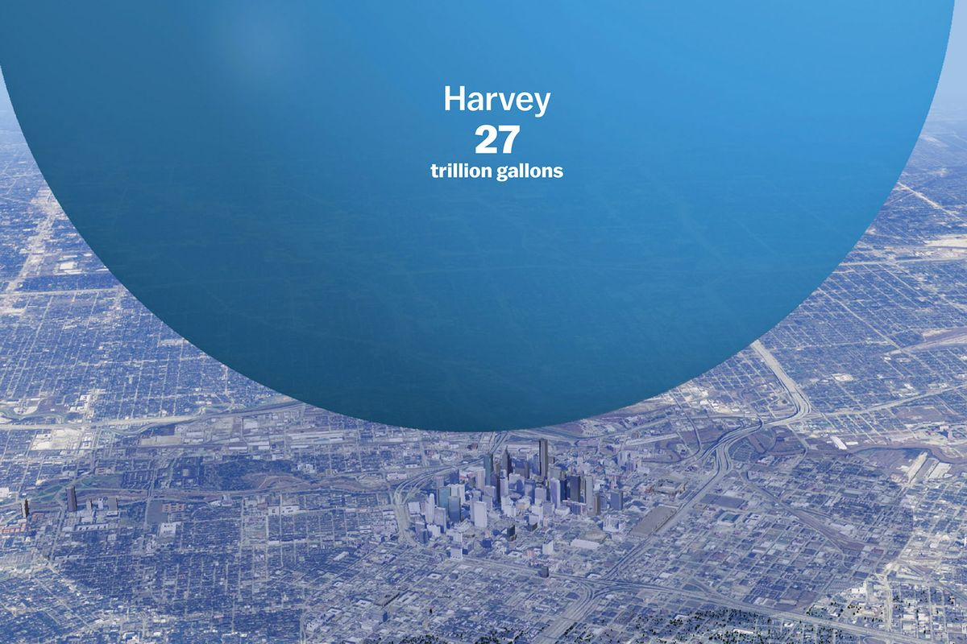
Gargantuan instruments
DAQ
ARA6 Visible Ice
Michigan Capitol
267 ft

Slide 27
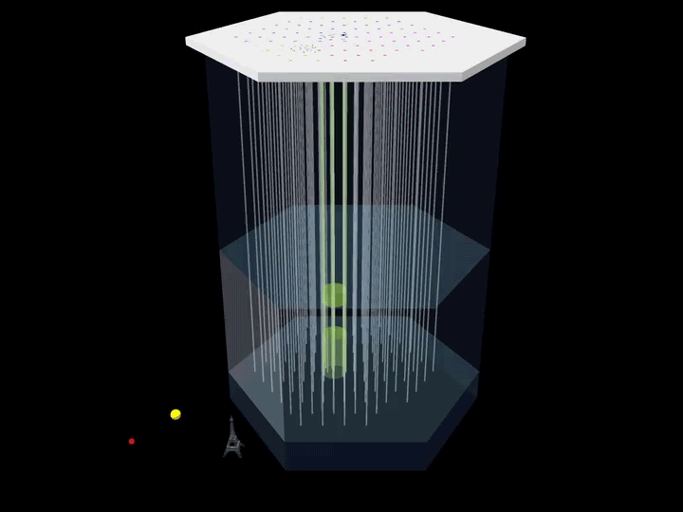
Neutrinos from blazars—first possible source!

Slide 28
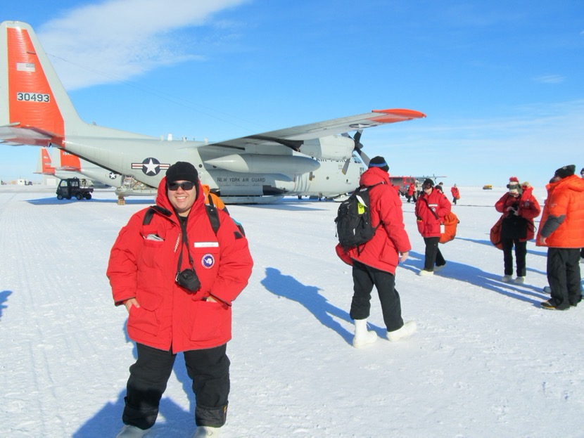
Thank you! Questions?
Notes:
Lucas, Spoorthi, Suren, Abdullah, Hannah,

Slide 29
But do THESE high-energy NEUTRINOS actually exist?

Slide 31
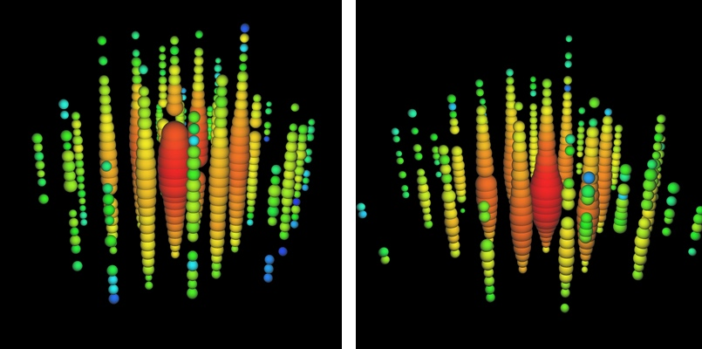
2012: IceCube reveals ”Bert and Ernie”
First cosmic neutrinos
Notes:
Just to demonstrate that they exist and show how big they are

Slide 32
Notes:
Just to demonstrate that they exist and show how big they are

Slide 33
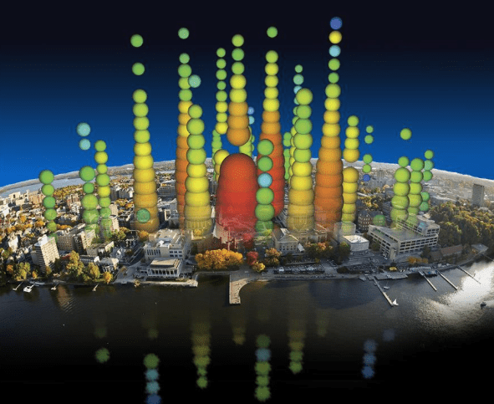
Notes:
Just to demonstrate that they exist and show how big they are

Slide 34
(Two OF) The Big, open questions

Slide 35
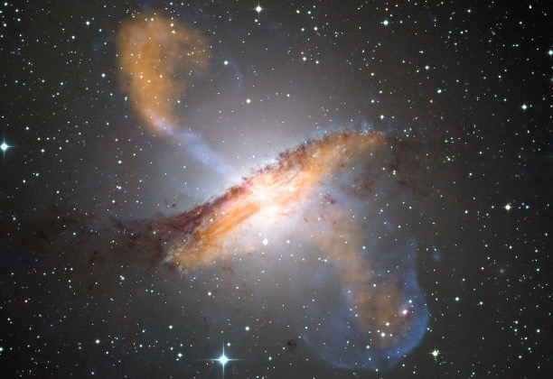
Active Galactic Nucleus Centaurus A.
(ESO public image release)
What are the neutrino “engines”?

Slide 36
What can we do with them?

Slide 37
Neutrino energy ~10¹⁸ eV
1,000,000,
000,000,
000,000

Slide 38
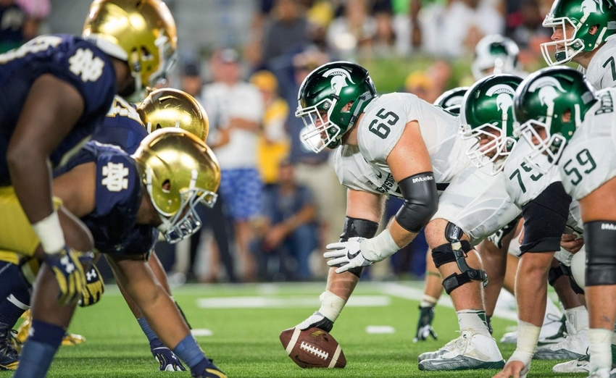
IC: Matt Cashore, USA Today

Slide 39
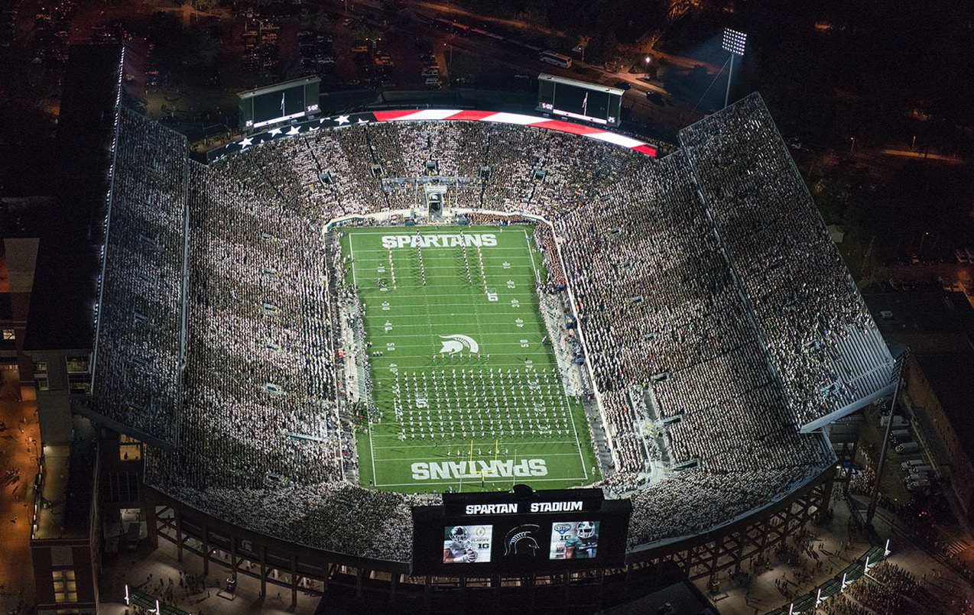
Passes through Spartan stadium ~1/year
Interacts ~1/decade

Slide 40
A rare particle that also interacts rarely.

Slide 41
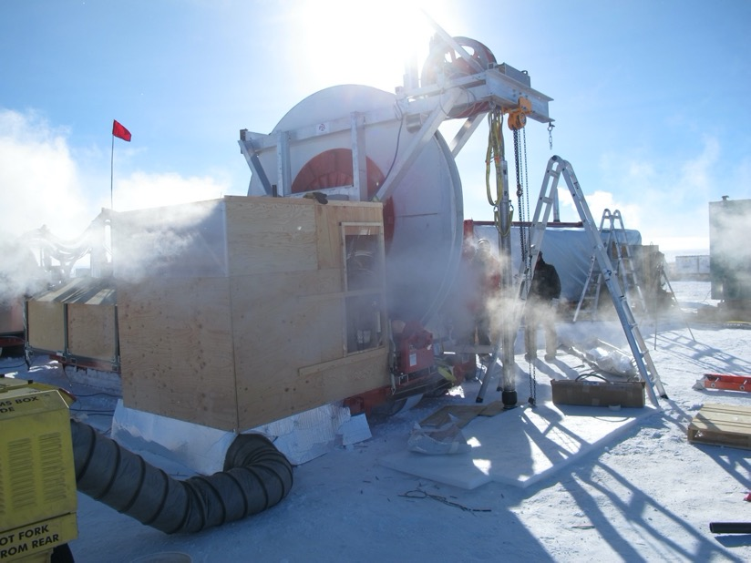
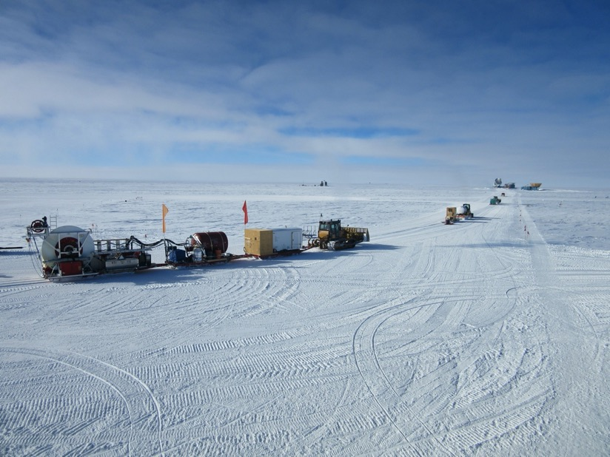
How to build the world’s biggest telescope
DRIVE
+
DRILL
TRACTOR

