Slide 1
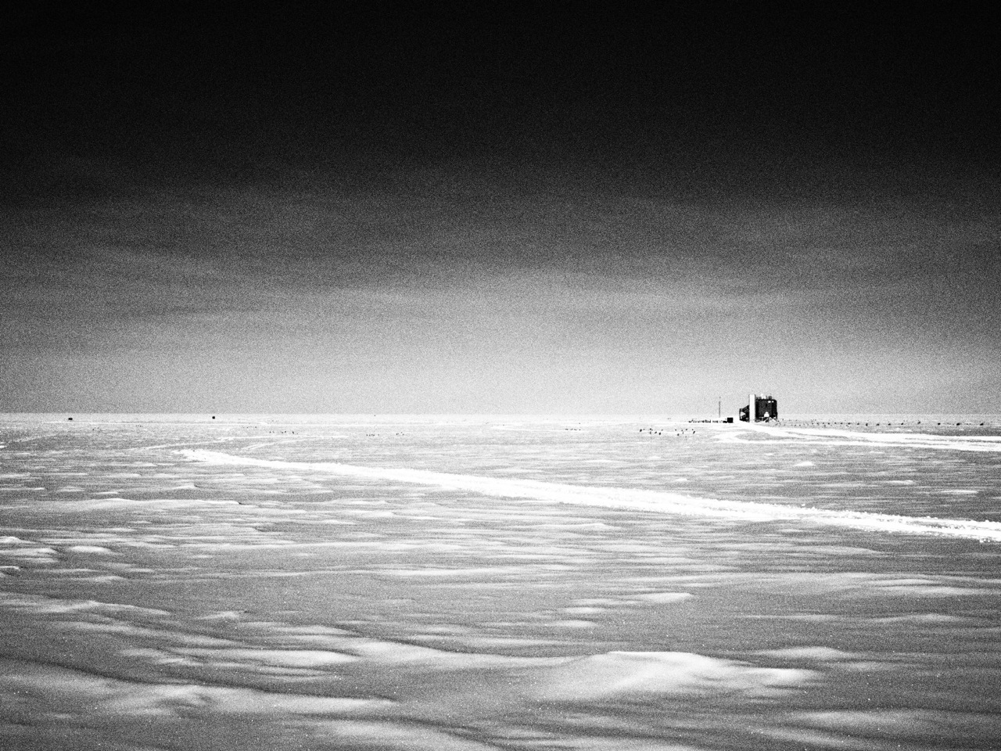
The Cosmic Ray and Neutrino Connection: Extreme Astrophysics at the Ends of the Earth
John Kelley
Wisconsin IceCube Particle Astrophysics Center
University of Wisconsin – Madison, U.S.A.
Embry-Riddle Aeronautical University
September 17, 2013

Slide 2
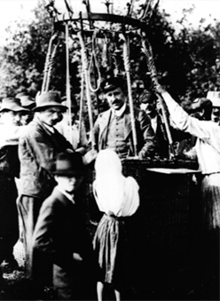
A 100-Year-Old Mystery...
Cosmic rays: charged particles coming from everywhere in the sky
Energies up to 10²⁰ eV (16 J)
What are they and where do they come from?
How do they reach such enormous energies?
What can we learn about particle physics at such extremes?
Can we do astronomy with particles?
V. Hess balloon flights, 1911-12

Slide 3
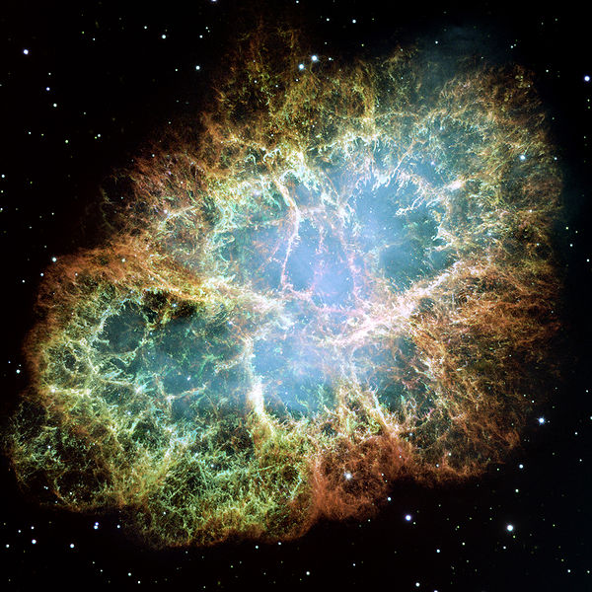
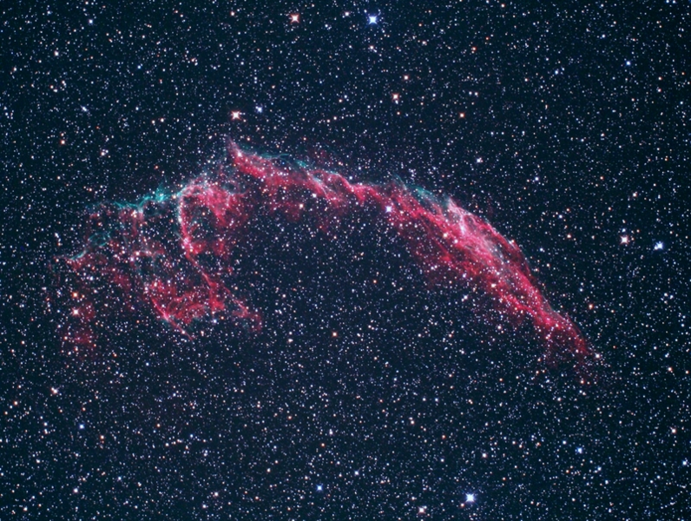
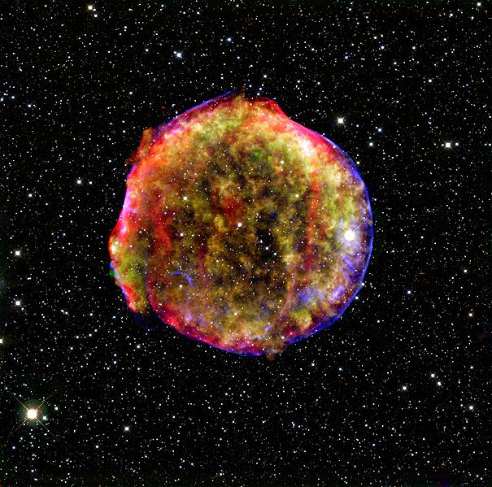
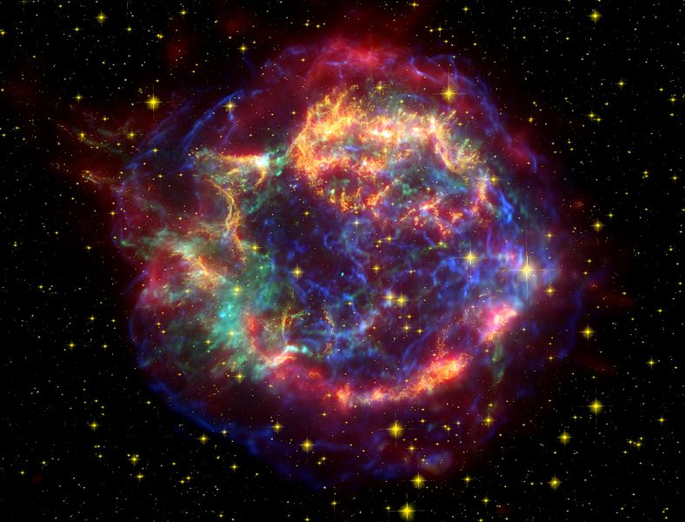
Nature’s Accelerators: SNRs?
Crab nebula (M1)
Hubble, false color
Veil nebula
(NGC6992, etc.)
optical
Tycho (SN1572 / B Cas)
X-ray / infrared
Cassiopeia A
X-ray / optical / infrared
several supernova remnants (SNR) in our Galaxy

Slide 4
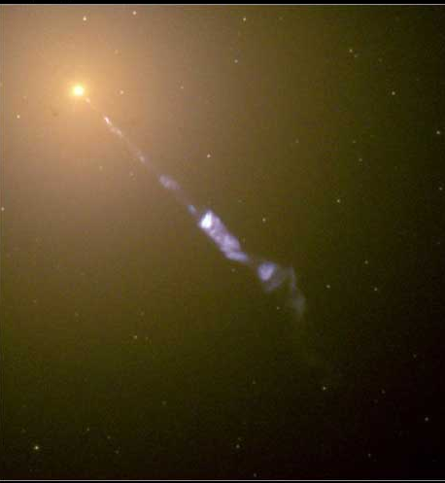
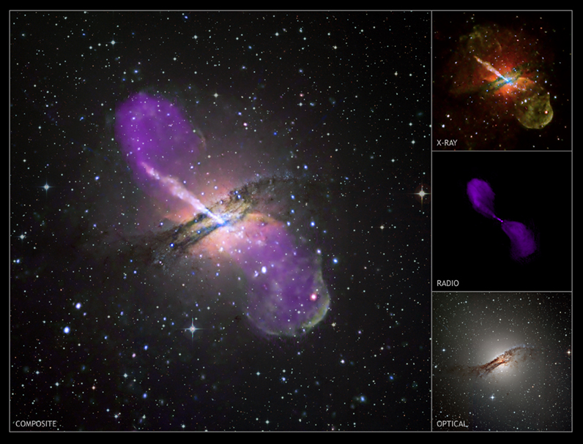
M87
Nature’s Accelerators: AGN?
Centaurus A (NGC 5128)
composite images of two active galactic nuclei (AGN)

Slide 5
Different Locations, Same Particle Physics
High-energy proton collides with anything:
pions!
Decay to gamma-rays,
muons, neutrinos, etc.
Process is happening in:
cosmic ray sources (ambient light, gas)
outer space (cosmic microwave background)
Earth’s atmosphere (N, O, etc. nucleus)
These are the cosmic-ray / neutrino connections

Slide 6
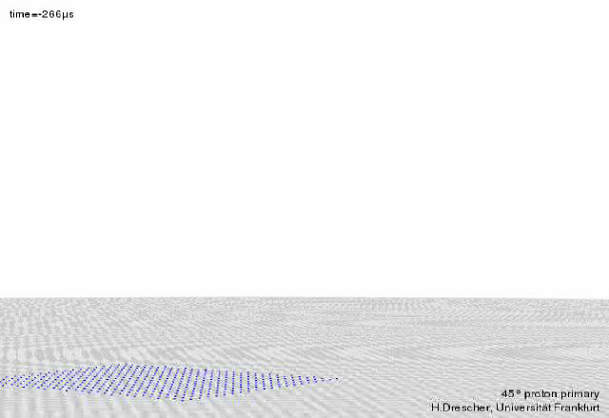
Cosmic Ray Air Shower Simulation
blue:electrons/positrons
cyan:photons
red:neutrons
orange: protons
gray: mesons
green:muons
???: neutrinos

Slide 7
Energy Spectrum
1 particle per m²
per second
“low” energy:
go to space!
“Knee”:
1 particle per m² per year
Particle flux
high energy:
huge detectors
on the ground!
“Ankle”:
1 particle per km² per year
Gaisser 2004
Cosmic Ray Energy

Slide 8
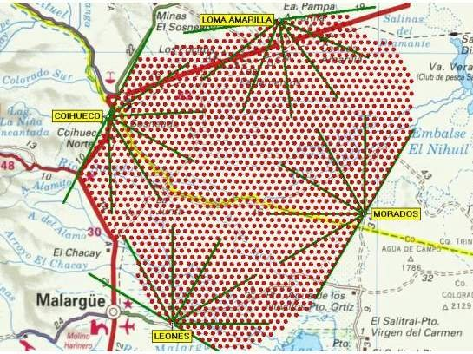
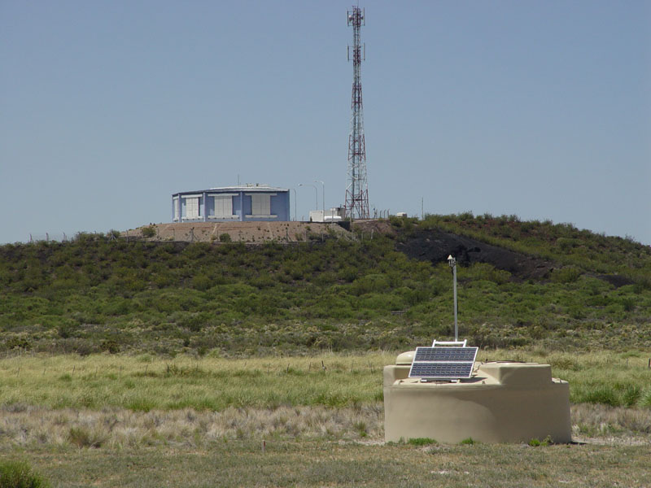
Pierre Auger Observatory
Hybrid cosmic ray air shower detector
Southern site (3000 km²) in Argentina completed 2008
Energy threshold:
  E > 10¹⁸ eV full array
  E > 10¹⁷ eV infill array

Slide 9
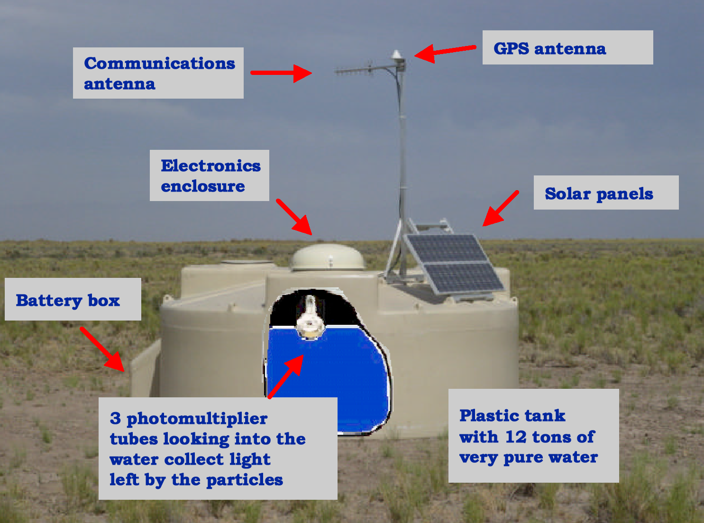
A Water Cherenkov Detector

Slide 10
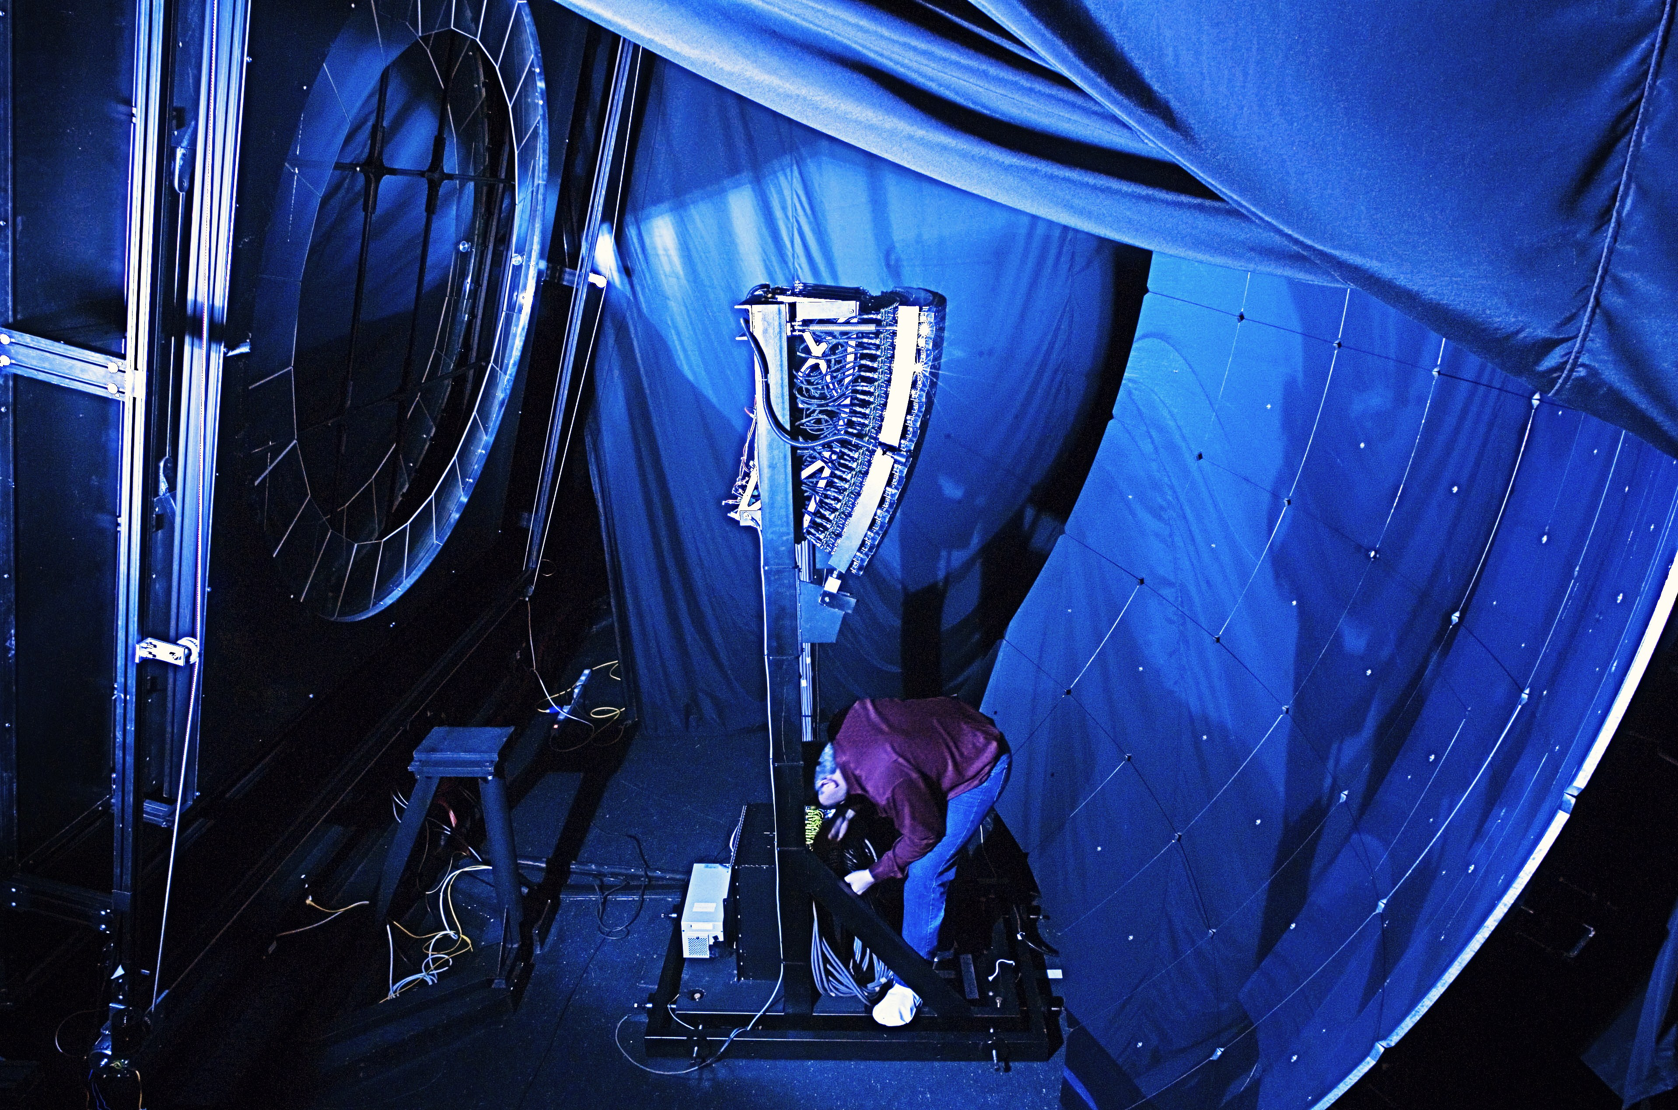
An Air Fluorescence Telescope
30º x 30º
Field of View
30º x 30º
Field of View
camera
440 PMTs
UV filter 300-400 nm
UV-Filter 300-400 nm
2.2m diameter aperture stop with Schmidt corrector ring.
Camera
440 PMTs
2.2m diameter aperture stop with Schmidt corrector ring
3.8m x 3.8m mirror
3.8m x 3.8m mirror

Slide 11
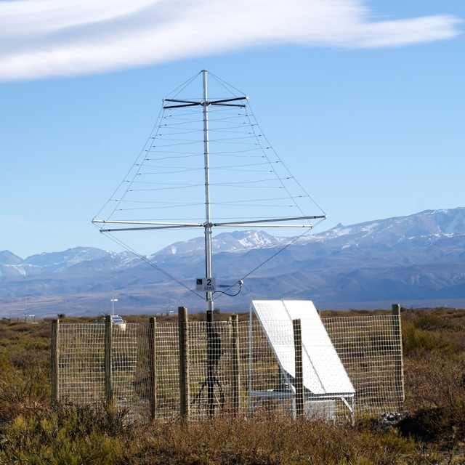
A Prototype Radio Detector Station (AERA)
30-100 MHz radio pulse from
charged particles in shower +
Earth’s magnetic field

Slide 12
Hybrid Observation

Slide 13
Hybrid Observation

Slide 14
Hybrid Observation

Slide 15
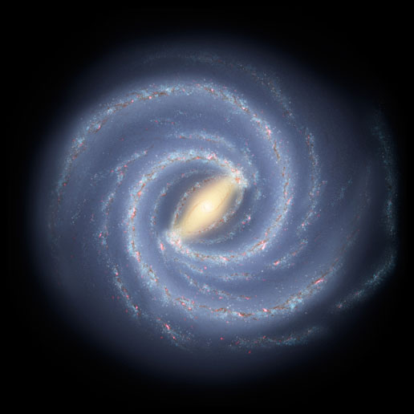
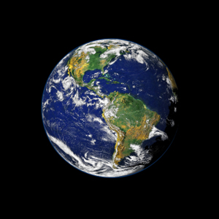
Directions of Cosmic Rays
  Astropart. Phys. 34 (2010) 314
2009: 69 events above 55 EeV
Excluding data from exploratory scan: 21 of 55 events correlate with nearby AGN in VCV catalog (38%; 21% expected for isotropy)
P-value of isotropic hypothesis: 0.003 (3.0σ)

Slide 16
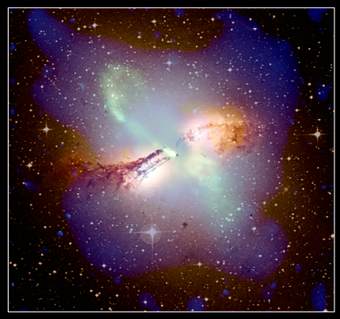
Centaurus A Region (a posteriori)
Cen A: closest AGN (3.7 Mpc)
Largest CR overdensity within 4º of Cen A core
Investigations ongoing (e.g. is composition from CenA region different?)

Slide 17
UHE Cosmic Ray Composition
depth of shower maximum
fluctuations in depth of shower maximum
Both indicate composition getting heavier…
but is this consistent with skymap / AGN correlation?
  Phys. Rev. Lett 104 (2010) 901101

Slide 18
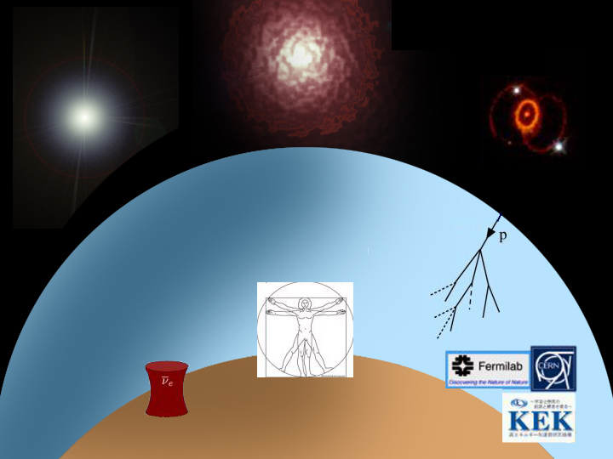
Sources of neutrinos :
nuclear reactions
/ decay
the Big Bang
Supernova
1987A
  the Sun
cosmic ray sources
the atmosphere
nuclear reactors
  Earth’s radioactivity
accelerators

Slide 19
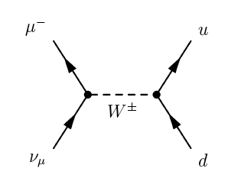
How Do We Detect ν?
Need an interaction — small cross-section necessitates a big target!
Then detect the interaction products (say, using their radiation)
Cherenkov
effect
μ

Slide 20
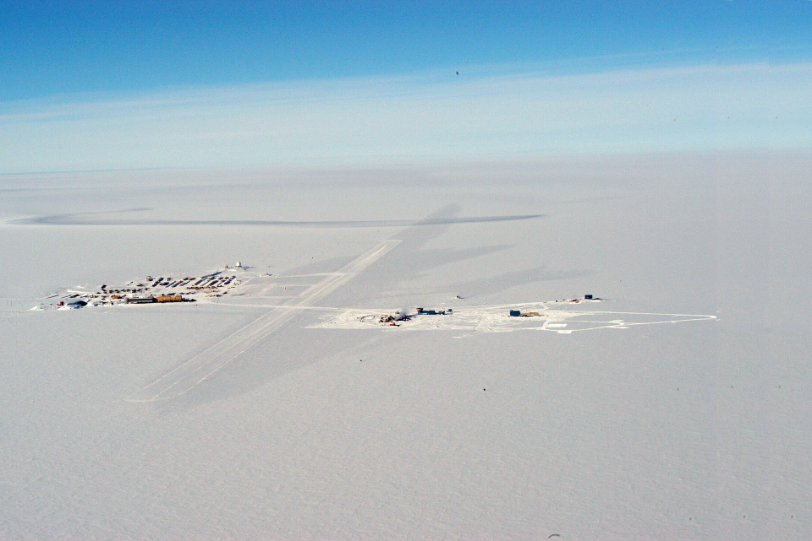
IceCube from the Air
IceCube
South Pole Station
control room
skiway

Slide 21
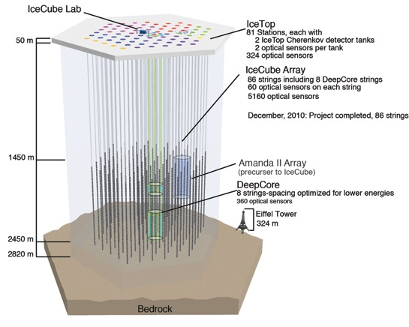
The IceCube Detector
AMANDA-II Array
(precursor to IceCube)
digital optical module (DOM)

Slide 22
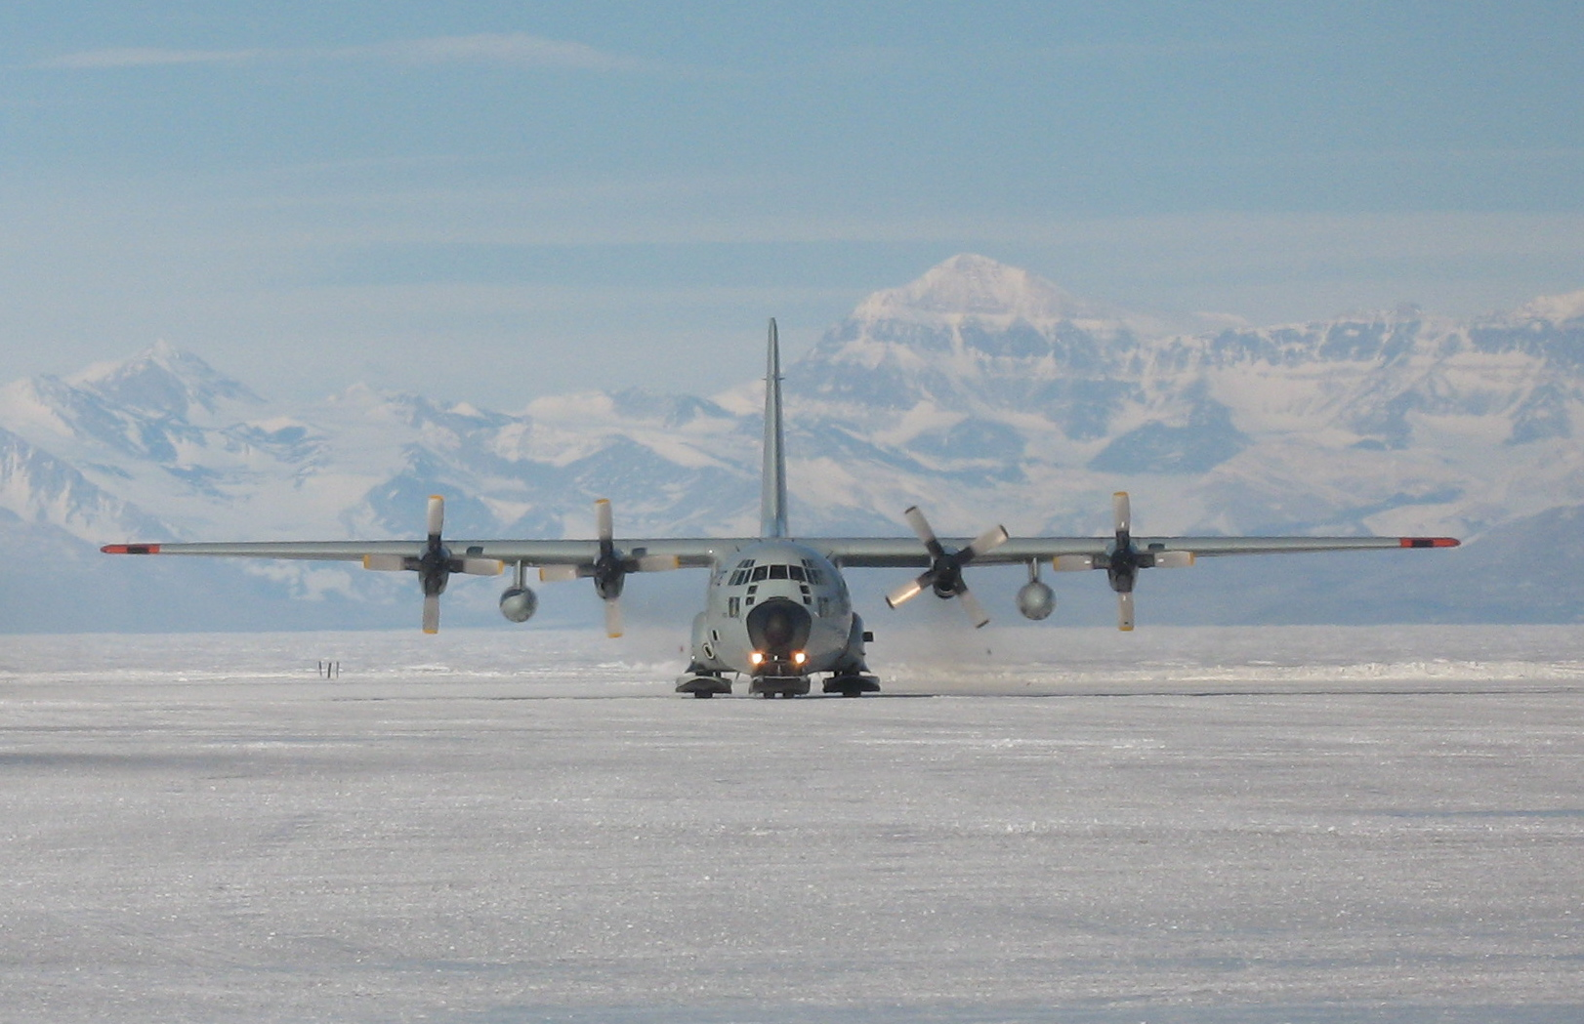
Logistics
900 tons of cargo and fuel
300 “Hercules” LC-130 missions (skiers)

Slide 23
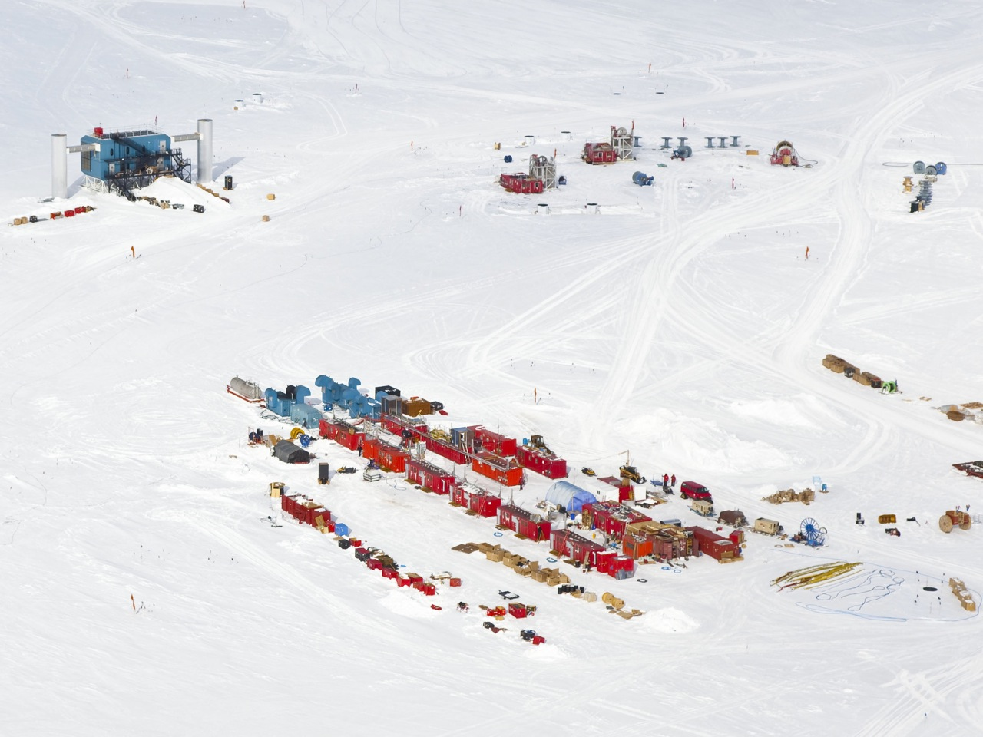
Hot water drilling

Slide 24
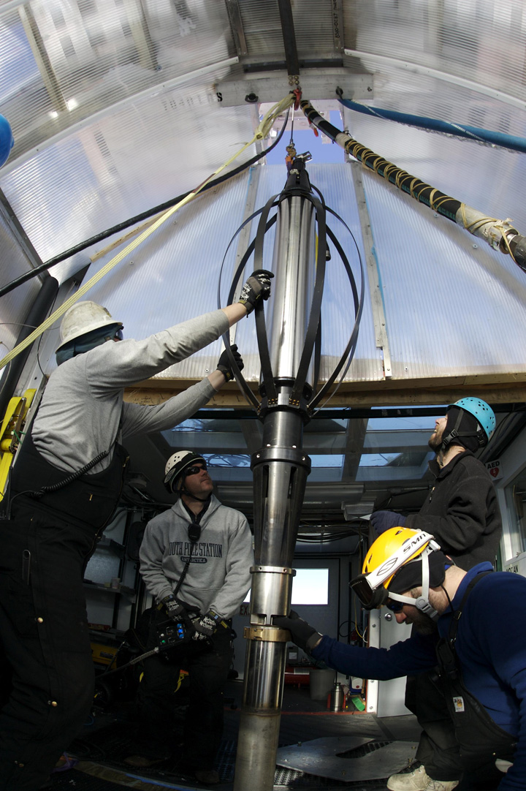
Drillers pull out the drillhead.

Slide 25
60 photomultipliers/string
Installation time:
10h/string

Slide 26
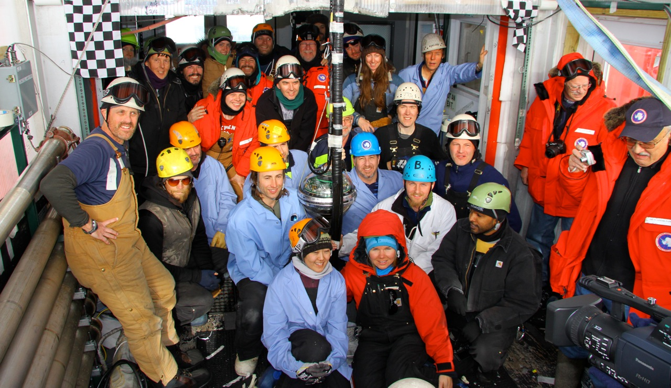
Dec 18, 2010: final DOM deployed

Slide 27
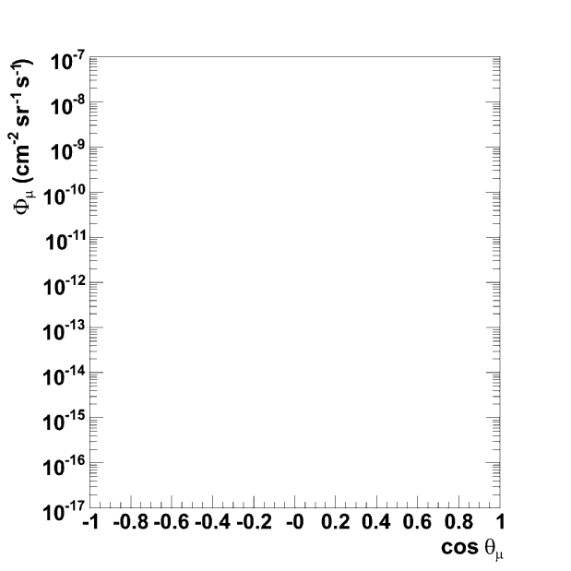
Detection Principle
astrophysical ν
cosmic ray
Northern Sky
atmospheric µ
atmos ν
ν-induced µ
ν_{atm}
Cosmic-ray muons: ~3000 / second!
Atmospheric neutrinos: ~1 / 10 minutes
Astrophysical neutrinos: ???
atmospheric μ
cosmic ray
Southern Sky

Slide 28
Event Signatures
Positions, times, and amplitudes of Cherenkov light deposition: neutrino direction + energy
up-going muon: ν_{μ}
cascade → all flavors
Down-going μ
background
& EHE ν
ν_{e}
ν_{e} CC + all flavor NC
μ
ν_{μ}
“Tracks”: good direction, not-so-good energy resolution
“Cascades”: good energy resolution, no-so-good direction

Slide 29
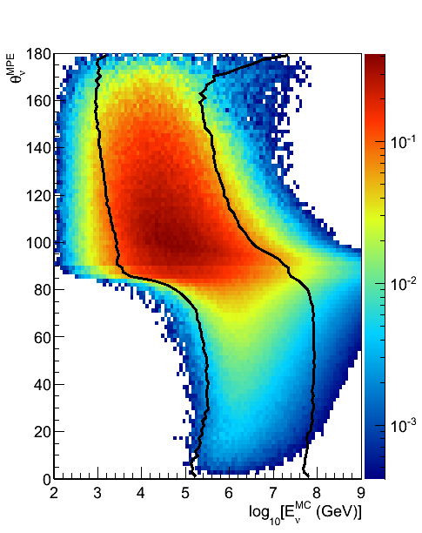
Neutrino Point Source Searches
δ
σ
r.a.
Unbinned likelihood search to search
for time-independent clustering
Covers both hemispheres
(different backgrounds, energy regimes)

Slide 30
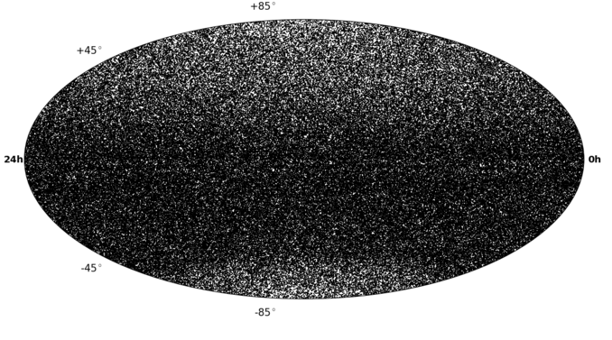
IC79+IC59+IC40 Neutrino Sky
Atm. neutrinos
Total events (IC40+IC59+IC79): 108317 (upgoing) + 146018 (downgoing)
Livetime: 316 days (IC79) + 348 days (IC59) + 375 days (IC40)
Atm. muons
?

Slide 31
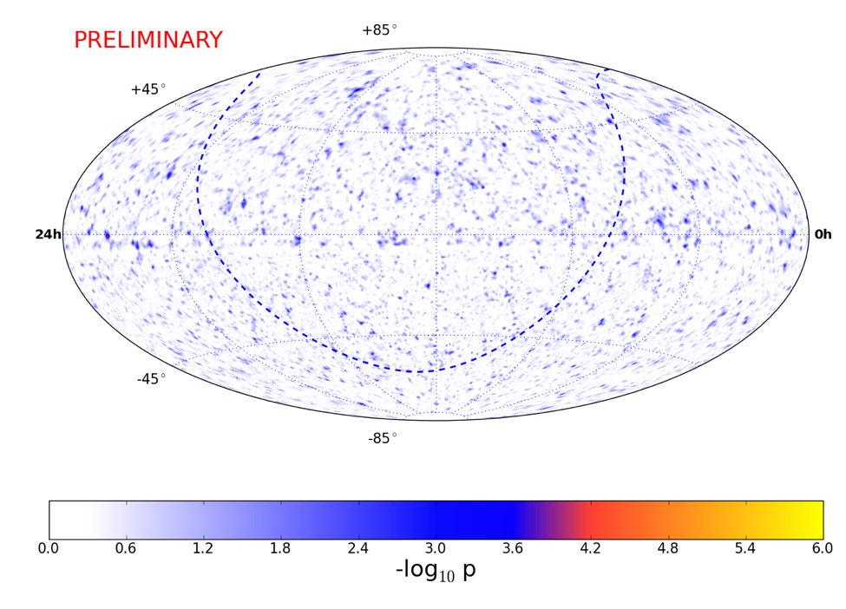
IC79+IC59+IC40 Neutrino Sky
Atm. neutrinos
Total events (IC40+IC59+IC79): 108317 (upgoing) + 146018 (downgoing)
Livetime: 316 days (IC79) + 348 days (IC59) + 375 days (IC40)
Atm. muons
No significant cluster found yet (or correlation with source list)
?

Slide 32
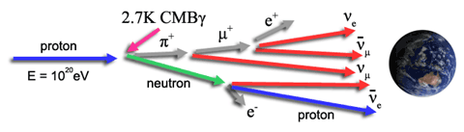
Ultra-high Energy Neutrino Search
image courtesy JEM-EUSO
Interaction of UHE cosmic rays with cosmic microwave background
(GZK effect)
Also produces UHE neutrinos (“cosmogenic”, “GZK”, “BZ”)

Slide 33
IceCube EHE Neutrino Search
PRELIMINARY
May 2010 – May 2012 (672.7 days livetime)
Primary selection criterion: high “NPE”
Track reconstruction quality removes corner-clippers, coincident CR events
see also first IceCube upper limits: Phys. Rev. D 82, 072003 (2010)

Slide 34
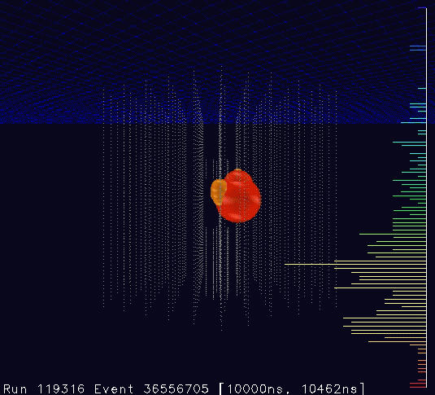
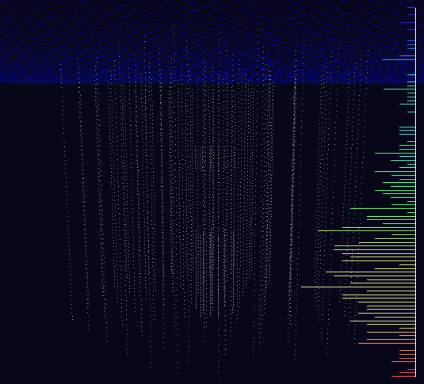
Highest-energy Neutrinos Ever Observed
Two cascade events in unblinded data sample
(background estimation: 0.14 events; 2.8σ, P = 0.29%)
9 Aug. 2011: 70k PE, 354 DOMs
3 Jan 2012: 96k PE, 312 DOMs
“Bert” ~1100 TeV
“Ernie” ~1300 TeV
Phys. Rev. Lett. 111, 021103 (2013)

Slide 35
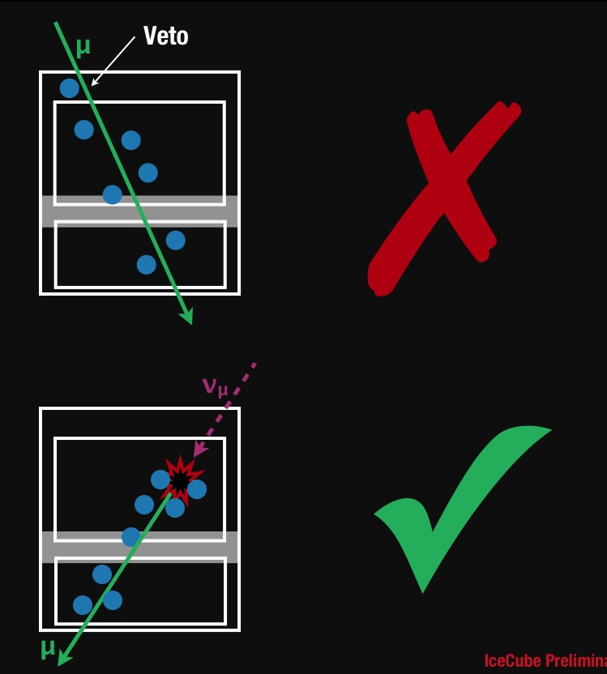
How to find more?
High-energy starting event search (May 2010 to May 2012)
Veto layer excludes atmospheric muons and some atmospheric neutrinos
Sensitive to all flavors, all directions
courtesy C. Kopper

Slide 36
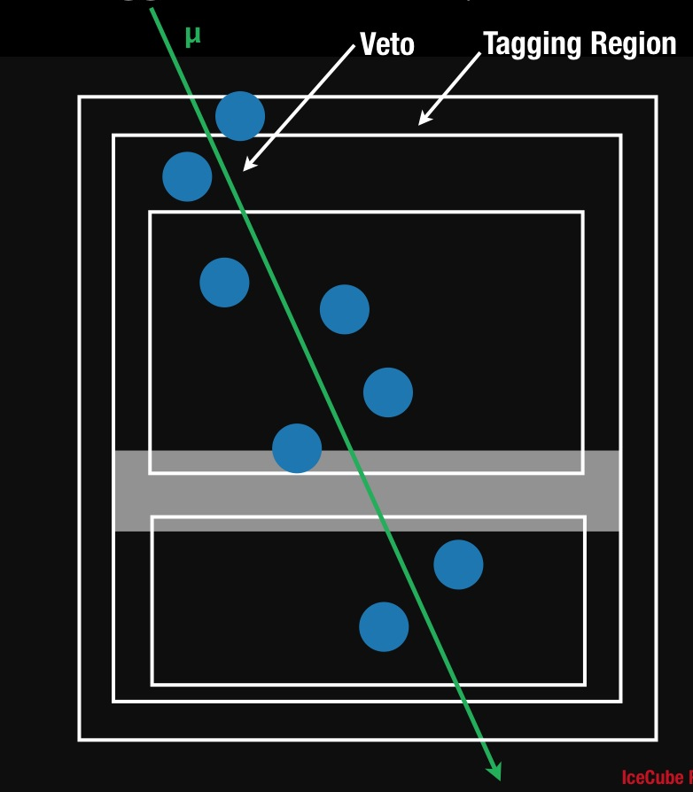
Muon Background Estimation From Data
Add one layer of DOMs to “tag” known background events
  use these to evaluate veto efficiency
Can be checked at lower energies where background dominates
Estimated muon background:
  3 ± 1.5 events / year
Remaining background is atmospheric neutrinos
  2.3 ^{+1.9}_{-0.6} events / year

Slide 37
Results: 26 more events
courtesy N. Whitehorn

Slide 38
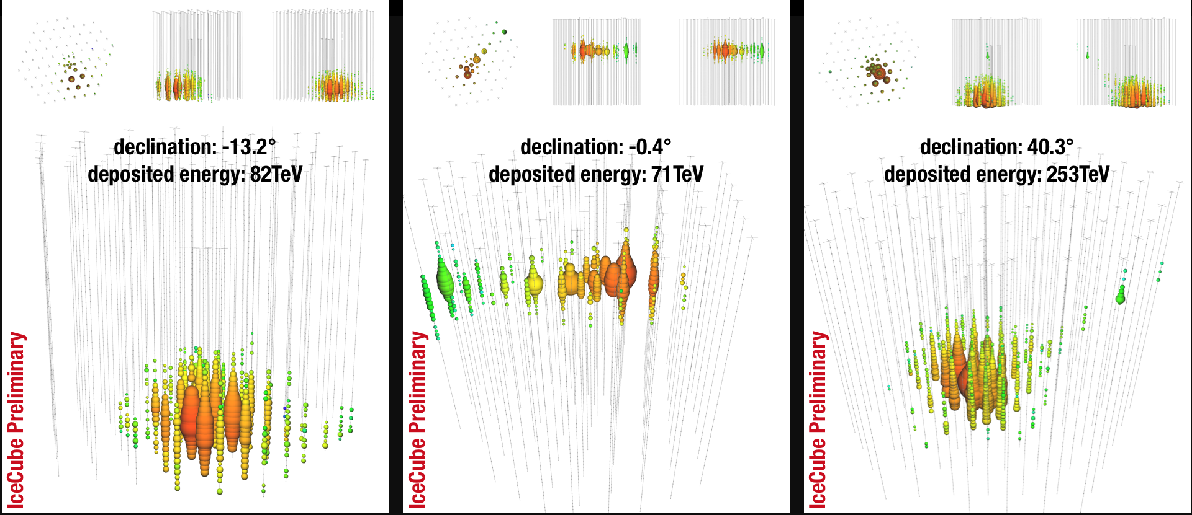
A Few Events

Slide 39
What Are They?

Slide 40
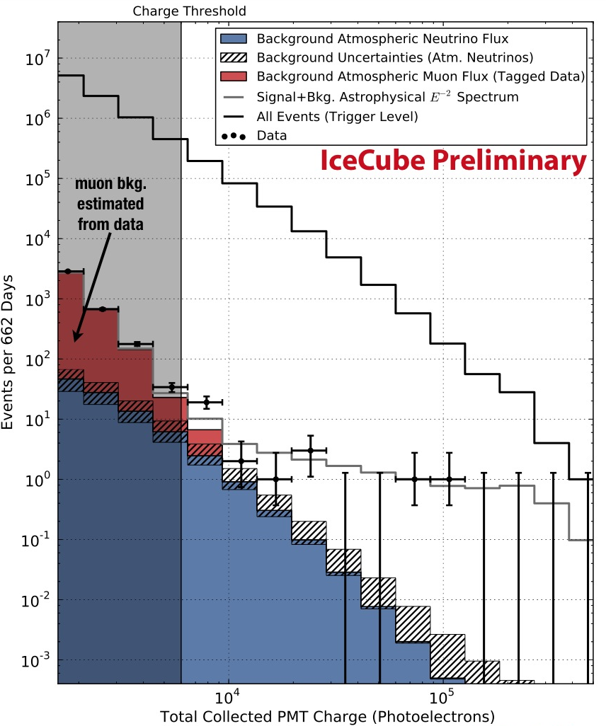
Charge (Brightness) Distribution
Fits well to tagged background estimates below charge threshold
Hatched region: uncertainties in atmospheric neutrino flux
Significance of excess: 4.1σ
(P = 0.004%)

Slide 41
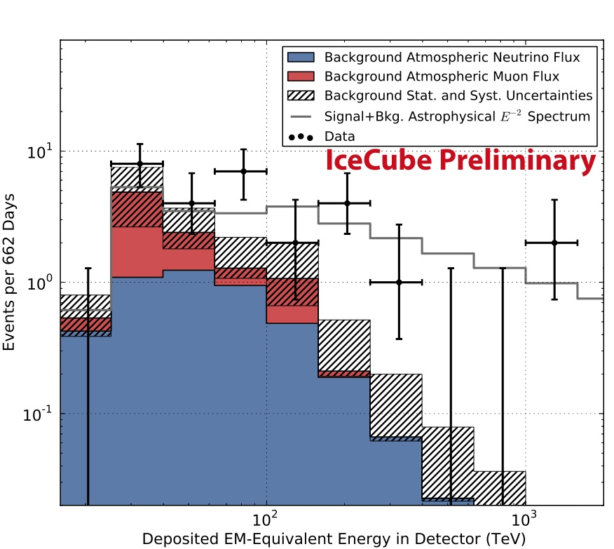
Deposited Energy Spectrum
Compatible with benchmark E⁻² astrophysical model
Potential cutoff at 2-5 PeV
Best-fit neutrino flux:
1.2±0.4×10⁻⁸
GeV cm⁻² s⁻¹ sr⁻¹

Slide 42
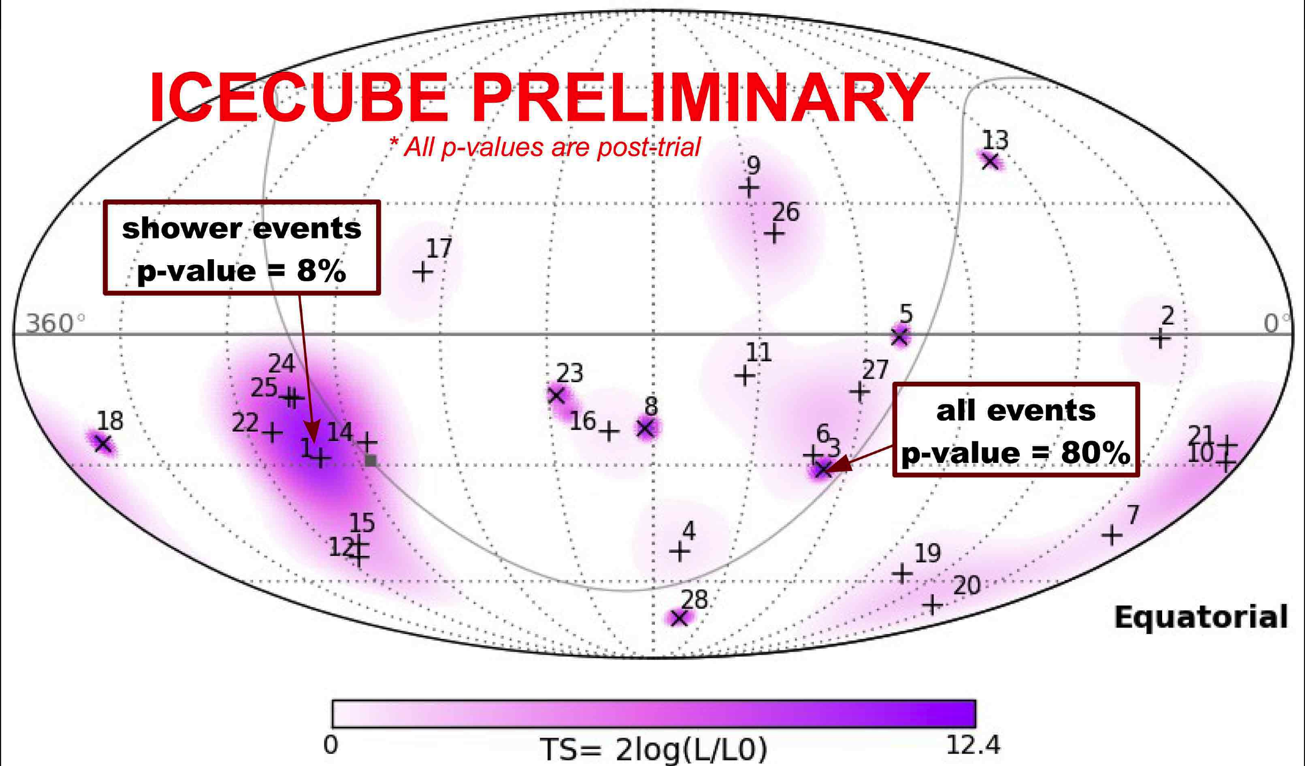
Skymap
courtesy N. Kurahashi
Compatible with isotropy: no significant cluster found

Slide 43
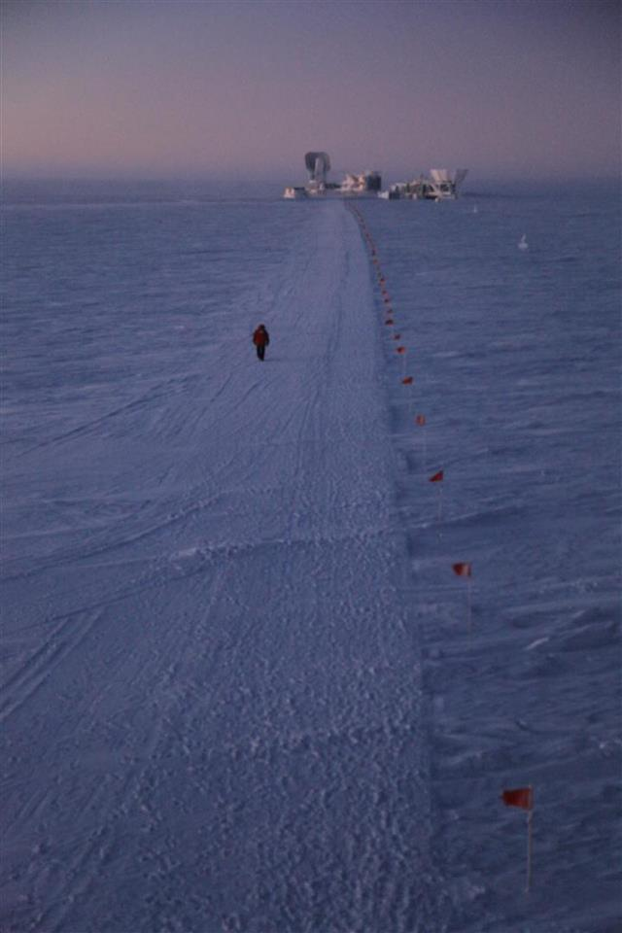
Summary
Answering the mysteries of high-energy cosmic rays:
huge particle detectors in remote locations
Pierre Auger Cosmic Ray Observatory
  cosmic ray arrival directions likely non-isotropic
  interesting clustering around Cen A
  composition at highest energies appears heavy
IceCube Neutrino Observatory
  28 high-energy neutrinos discovered in two years
  incompatible at 4.1σ with standard backgrounds
  consistent with an isotropic astrophysical signal
  more data coming soon!
Era of particle astronomy beginning?
photo credit: S. Lidstrom

Slide 44
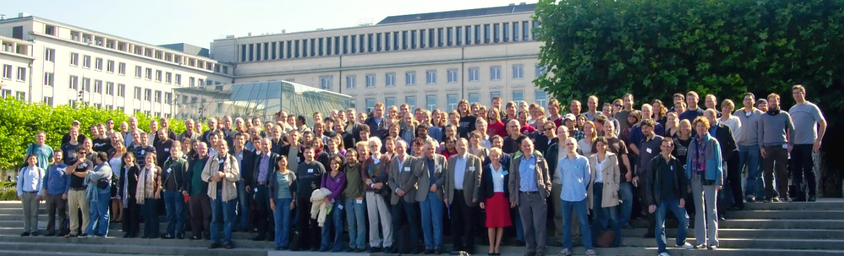



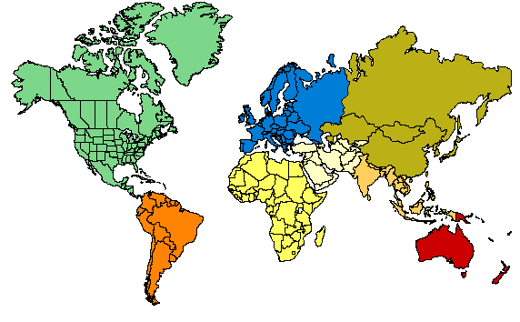






ICECUBE
COLLABORATION
10 countries, 40 institutions, ~260 collaborators
Universität Mainz, Germany
DESY Zeuthen, Germany
Universität Wuppertal, Germany
Universität Dortmund, Germany
Humboldt Universität, Germany
RWTH Aachen, Germany
Universität Bonn, Germany
Ruhr-Universität, Bochum, Germany
MPI, Heidelberg, Germany
Uppsala Universitet, Sweden
Stockholm Universitet, Sweden
Imperial College, London, UK
University of Oxford, UK
Université Libre de Bruxelles, Belgium
Vrije Universiteit Brussel, Belgium
Université de Mons, Belgium
Universiteit Gent, Belgium
EPFL, UniGe, Switzerland
Bartol Research Inst, Univ of Delaware, USA
University of Alaska Anchorage, USA
Pennsylvania State University, USA
University of Wisconsin-Madison, USA
University of Wisconsin-River Falls, USA
LBNL, Berkeley, USA
UC Berkeley, USA
UC Irvine, USA
Stony Brook University, USA
University of Alberta, Canada
Univ. of Alabama, USA
Clark-Atlanta University, USA
Georgia Tech
Ohio State University
Univ. of Maryland, USA
University of Kansas, USA
Southern Univ. and A&M College,
Baton Rouge, LA, USA
Chiba University, Japan
University of the West Indies, Barbados
University of Canterbury,
Christchurch, New Zealand

Slide 45
Backup Slides

Slide 46
Detector Performance
Simulated tracks
Simulated cascades
IC40
E⁻² spectrum
angular resolution: ~1º
energy resolution: ~35%
μ energy estimation via dE/dx
~30% in log₁₀(E)
angular resolution: ~10-30º
Continual time synchronization to ~2 ns; ice calibration with in-situ flashers

Slide 47
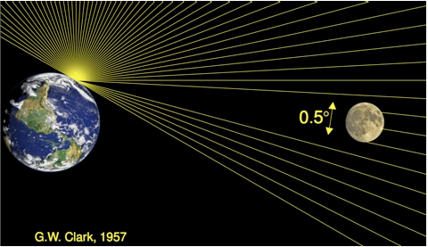
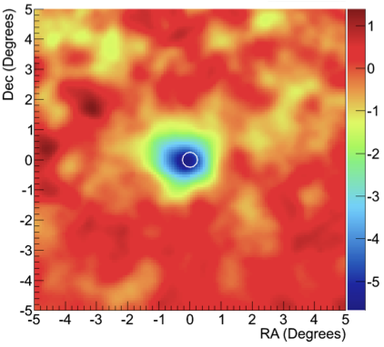
Shadow of the Moon

Slide 48
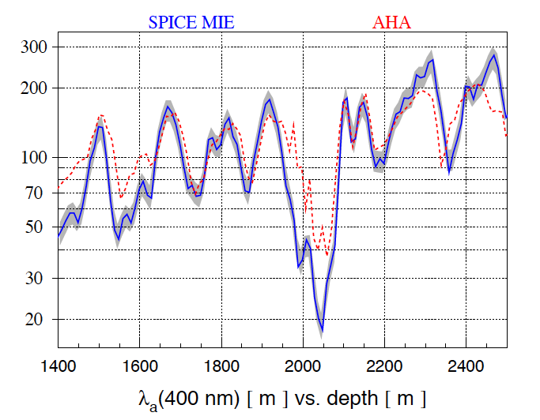
Ice Absorption length vs. Depth
Absorption length [m]

Slide 49
Cascade Directional Reconstruction

Slide 50
Location in Detector

