Slide 1
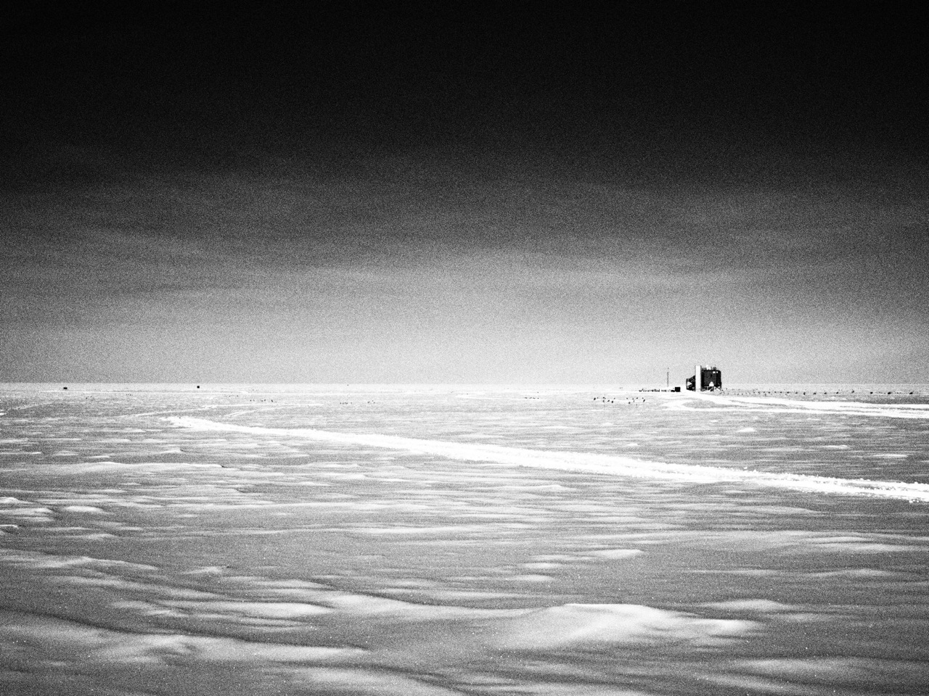
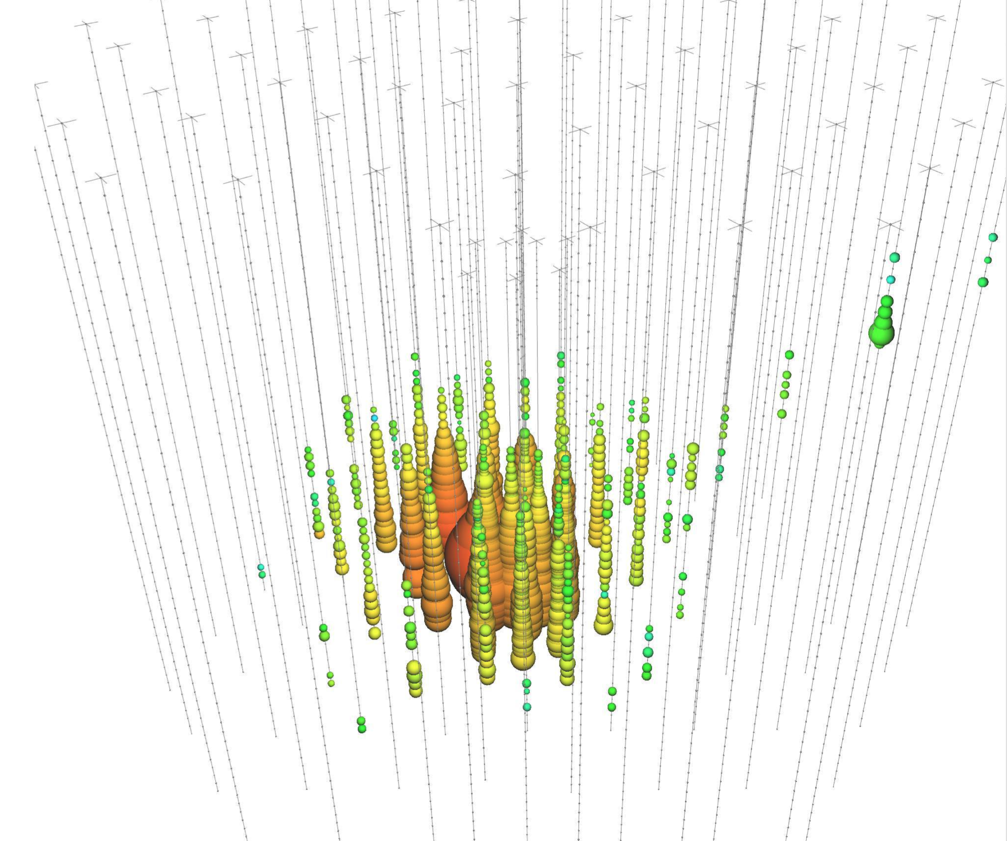
IceCube’s Observation of Cosmic Neutrinos
John Kelley
Wisconsin IceCube Particle Astrophysics Center
University of Wisconsin – Madison, U.S.A.
UW–Madison REU Talk
July 6, 2015

Slide 2
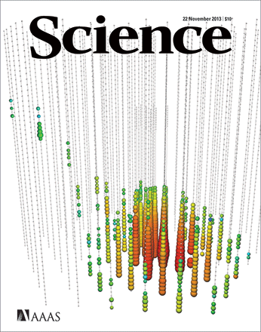
IceCube in the News

Slide 3
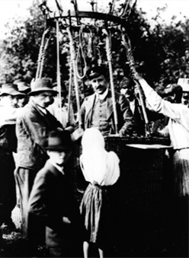
A 100-Year-Old Mystery...
Cosmic rays: charged particles coming from everywhere in the sky
Energies up to 10²⁰ eV (16 J)
What are they and where do they come from?
How do they reach such enormous energies?
What can we learn about particle physics at such extremes?
Can we do astronomy with particles?
V. Hess balloon flights, 1911-12

Slide 4
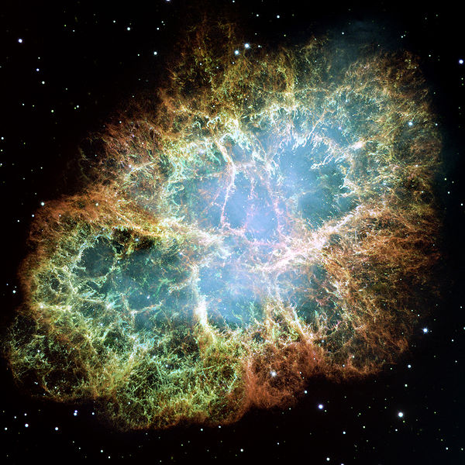
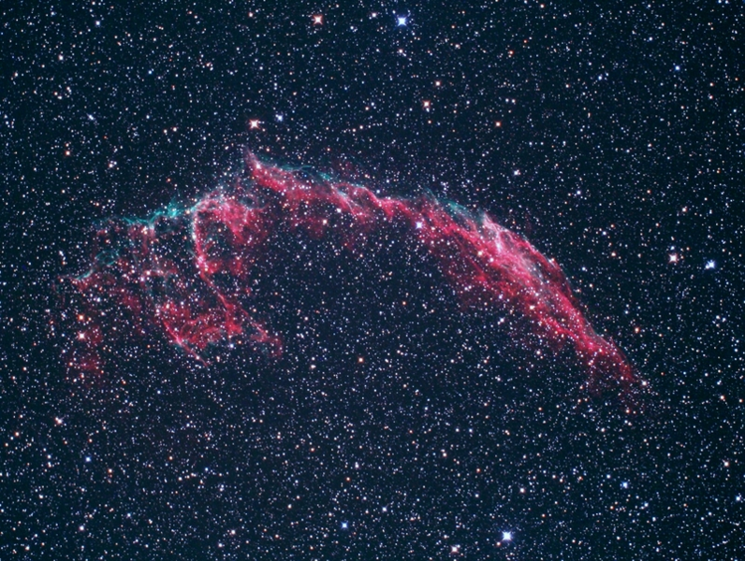
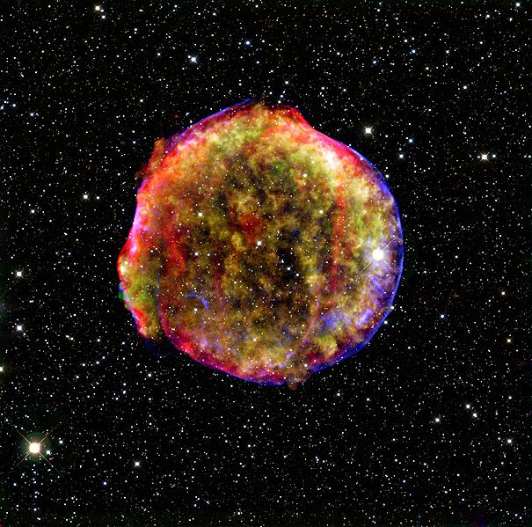
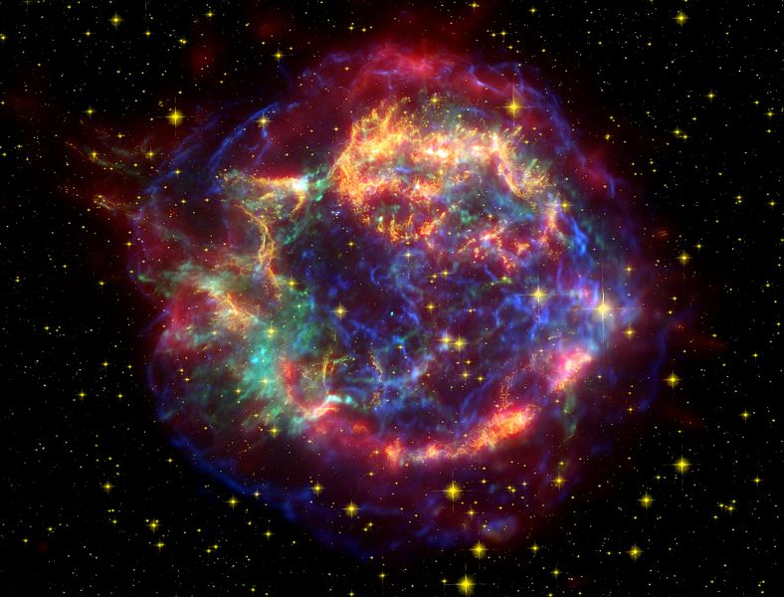
Nature’s Accelerators: SNRs?
Crab nebula (M1)
Hubble, false color
Veil nebula
(NGC6992, etc.)
optical
Tycho (SN1572 / B Cas)
X-ray / infrared
Cassiopeia A
X-ray / optical / infrared
several supernova remnants (SNR) in our Galaxy

Slide 5
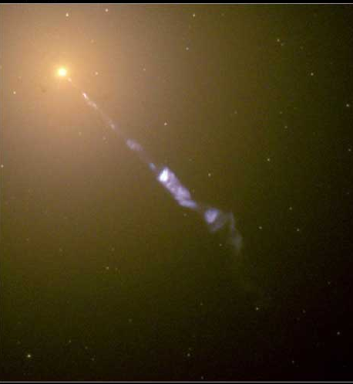
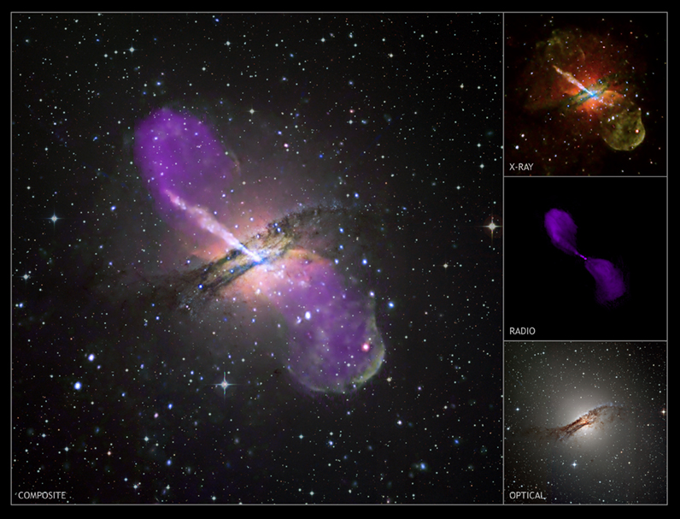
M87
Nature’s Accelerators: AGN?
Centaurus A (NGC 5128)
composite images of two active galactic nuclei (AGN)

Slide 6
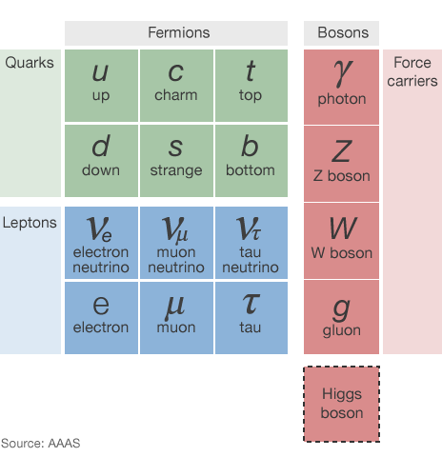
Particle Physics Primer
Everyday matter: up, down quarks and electrons
Three types or “flavor” of neutrino
  no electric or color charge
  small, unknown masses
  can oscillate / change flavor
Flavors related to the three charged leptons
  certain interactions can produce electron, muon, tau

Slide 7
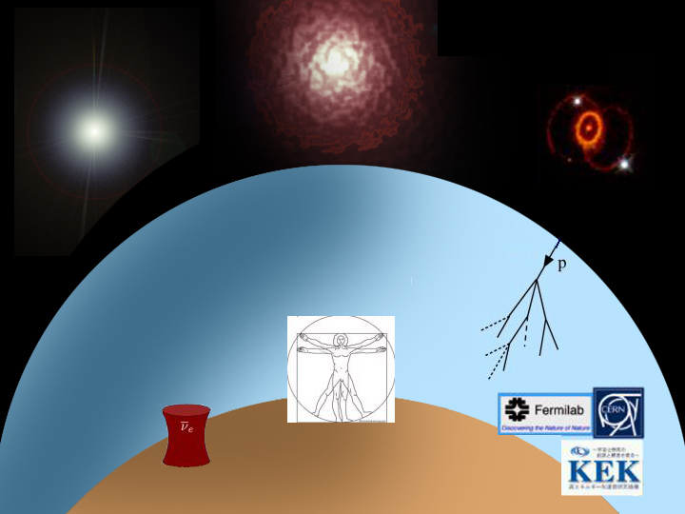
Sources of neutrinos :
nuclear reactions
/ decay
the Big Bang
Supernova
1987A
  the Sun
cosmic ray sources
the atmosphere
nuclear reactors
  Earth’s radioactivity
accelerators

Slide 8
Different Locations, Same Particle Physics
High-energy proton collides with anything:
pions!
Decay to gamma-rays,
muons, neutrinos, etc.
Similar processes happening in:
cosmic ray sources (ambient light, gas)
outer space (cosmic microwave background)
Earth’s atmosphere (N, O, etc. nucleus)
Cosmic rays and neutrinos are closely connected

Slide 9
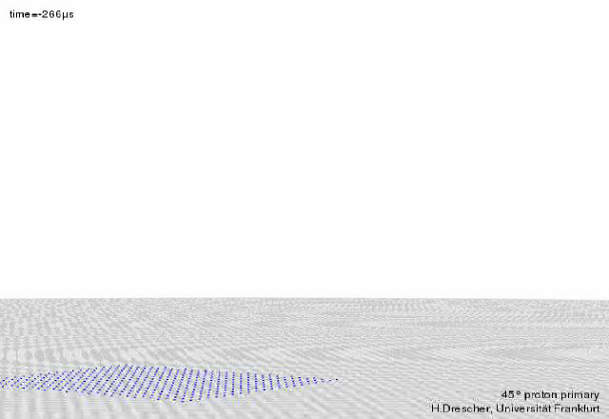
Cosmic Ray Air Shower Simulation
blue:electrons/positrons
cyan:photons
red:neutrons
orange: protons
gray: mesons
green:muons
???: neutrinos

Slide 10
How Do We Detect ν?
With difficulty! Most neutrinos pass completely through Earth.
Need to wait for an interaction / collision — necessitates a big target
Then detect the collision debris, i.e. other, more visible particles, using the light emitted
Cherenkov
effect
μ

Slide 11
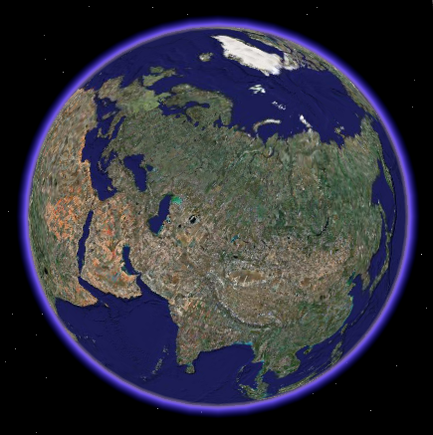
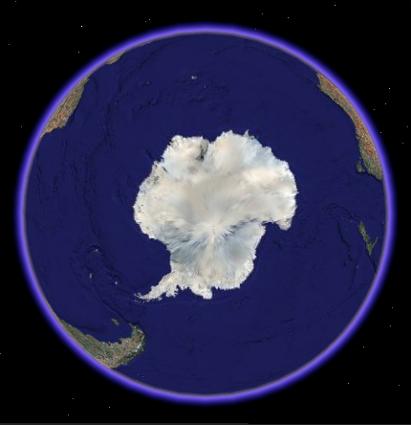
Earth’s Transparent Medium: H₂O
Mediterranean,
Lake Baikal
Antarctic ice sheet

Slide 12
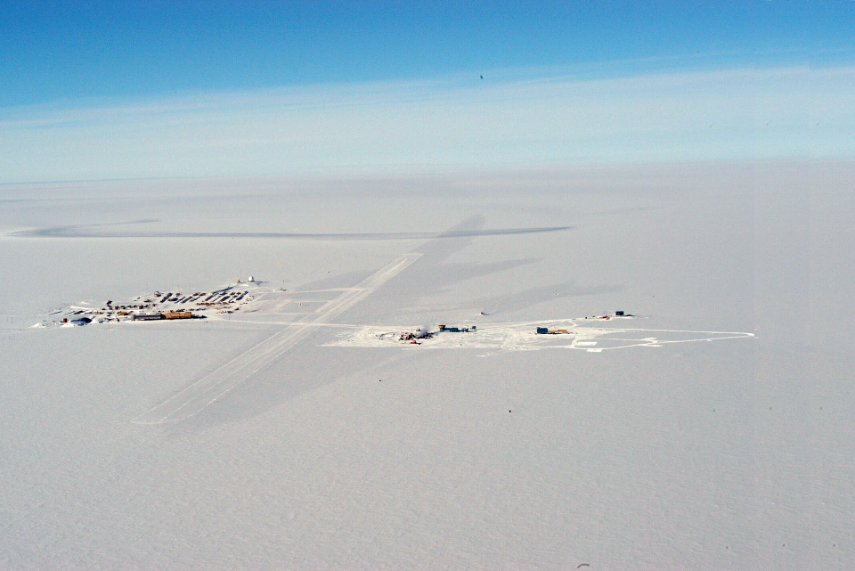
IceCube from the Air
IceCube
South Pole Station
IceCube Lab
skiway

Slide 13
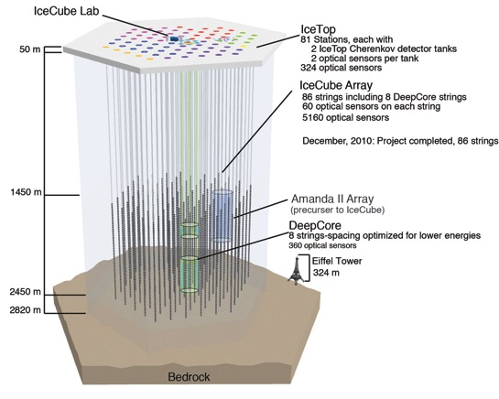
The IceCube Detector
AMANDA-II Array
(precursor to IceCube)
digital optical module (DOM)

Slide 14
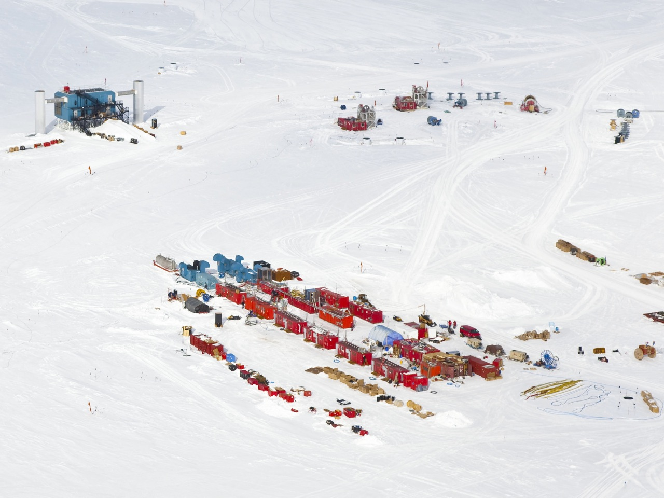
Hot water drilling

Slide 15
60 photomultipliers/string
Installation time:
10h/string

Slide 16
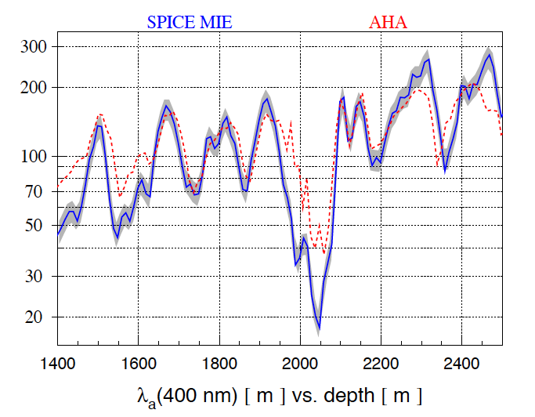
Deep Ice is Extremely Clear
Absorption length [m]

Slide 17
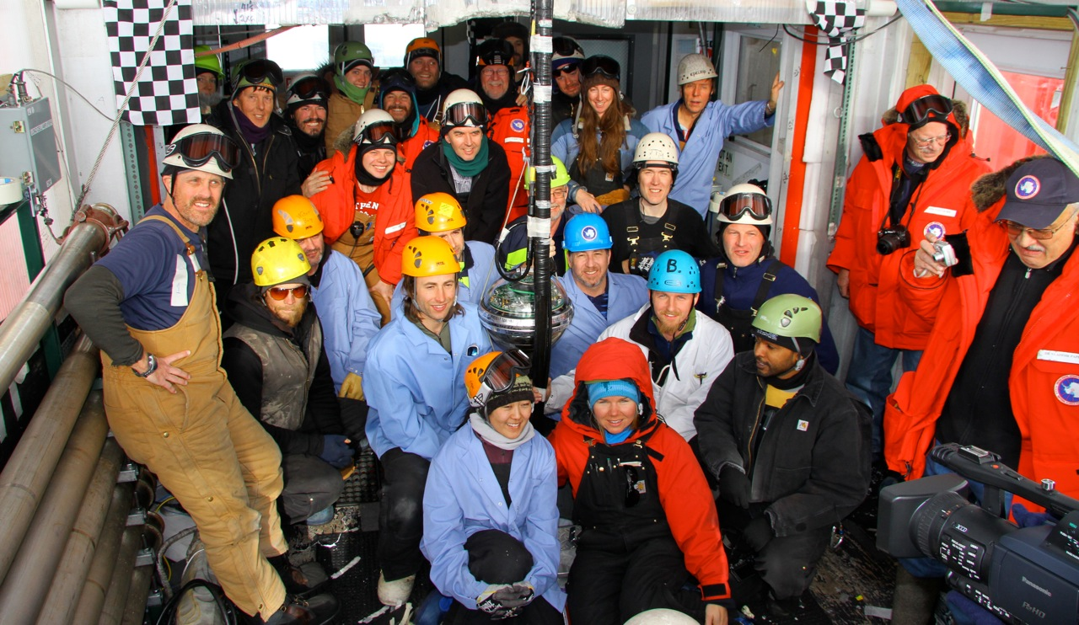
Dec 18, 2010: final DOM deployed

Slide 18
What IceCube Sees
astrophysical ν
cosmic ray
Northern Sky
Cosmic-ray muons:
~3000 / second!
Atmospheric neutrinos:
~1 / 10 minutes
Astrophysical neutrinos: ???
atmos ν
ν_{atm}
atmospheric μ
cosmic ray
Southern Sky

Slide 19
Event Signatures
Positions, times, and amplitudes of Cherenkov light deposition: neutrino direction + energy
up-going muon: ν_{μ}
cascade → all flavors
Down-going μ
background
& EHE ν
ν_{e}
ν_{e} CC + all flavor NC
μ
ν_{μ}
“Tracks”: good direction, not-so-good energy determination
“Cascades”, or “showers”: good energy determination,
not-so-good direction

Slide 20
Neutrino Point Source Searches
Basic idea: use track events, and look for clusters in the sky (atmospheric neutrinos and muons don’t cluster)
Unbinned likelihood search
Covers both hemispheres
(different backgrounds, energy regimes)
δ
σ
r.a.

Slide 21
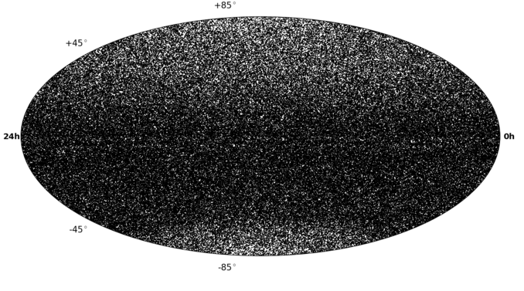
IceCube 3-year Neutrino Sky
Atm. neutrinos
Total events (IC40+IC59+IC79): 108317 (upgoing) + 146018 (downgoing)
Livetime: 316 days (IC79) + 348 days (IC59) + 375 days (IC40)
Atm. muons
?

Slide 22
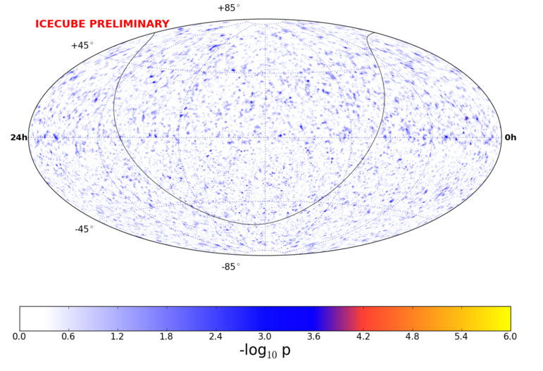
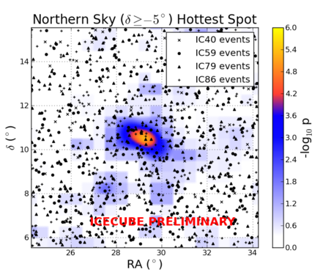
IceCube 4-year Neutrino Sky
Atm. neutrinos
Atm. muons
p-value: 22%
courtesy J. Feintzeig
No significant cluster found yet (or correlation with source list)
?

Slide 23
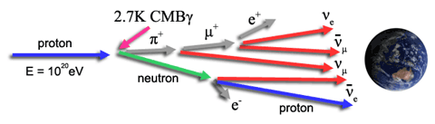
Ultra-high Energy Neutrino Search
image courtesy JEM-EUSO
Interaction of UHE cosmic rays with cosmic microwave background
(GZK effect)
Also produces UHE neutrinos (“cosmogenic”, “GZK”, “BZ”)

Slide 24
IceCube EHE Neutrino Search
PRELIMINARY
May 2010 – May 2012 (672.7 days livetime)
Primary selection criterion: high “NPE” / brightness
Expected background: 0.14 events
see also first IceCube upper limits: Phys. Rev. D 82, 072003 (2010)

Slide 25
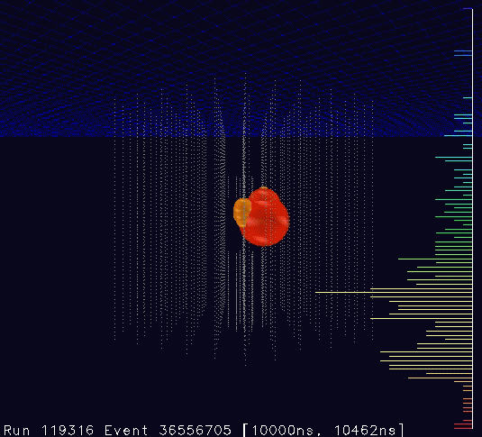
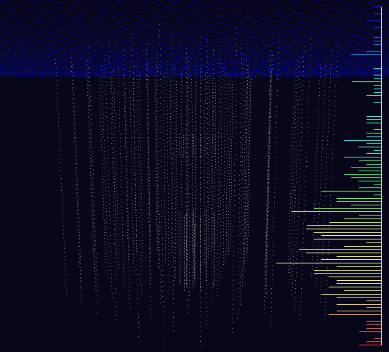
Highest-energy Neutrinos Ever Observed
Two cascade events in unblinded data sample
(background estimation: 0.14 events; 2.8σ, P = 0.29%)
9 Aug. 2011: 70k PE, 354 DOMs
3 Jan 2012: 96k PE, 312 DOMs
“Bert” ~1100 TeV
“Ernie” ~1300 TeV
Phys. Rev. Lett. 111, 021103 (2013)

Slide 26
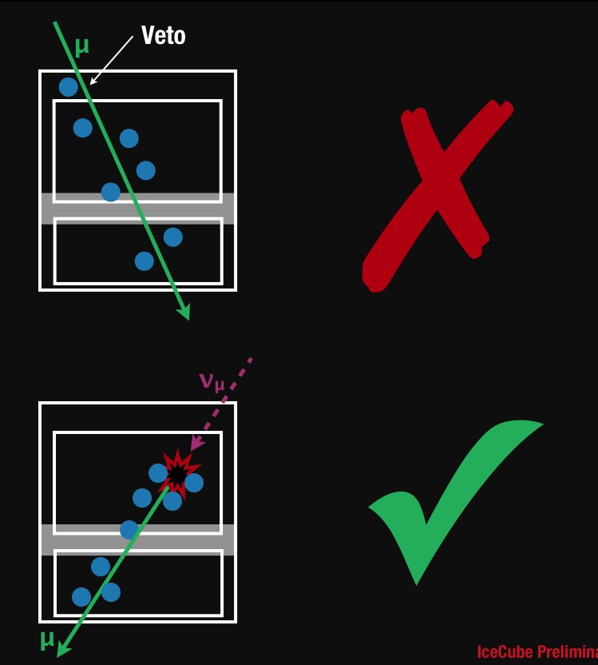
How to find more?
High-energy starting event search (May 2010 to May 2012)
Veto layer excludes atmospheric muons and some atmospheric neutrinos
Sensitive to showers and tracks
Sensitive in all directions
courtesy C. Kopper

Slide 27
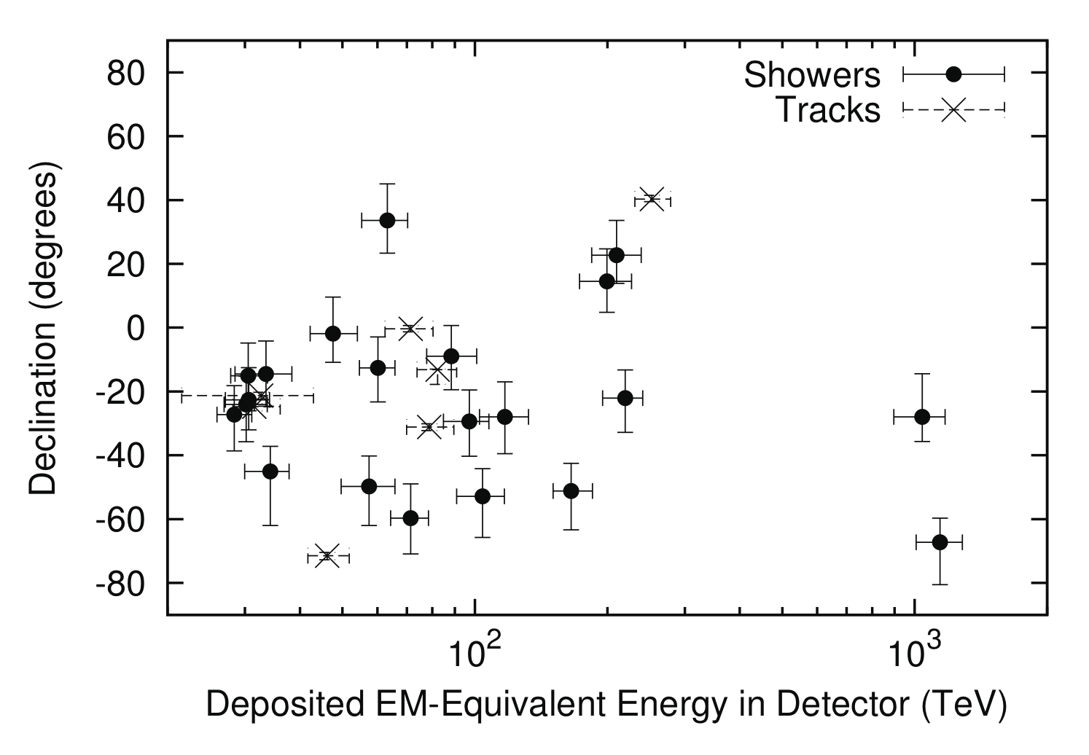
Results: 26 more events
Science 342, 1242856 (2013)

Slide 28
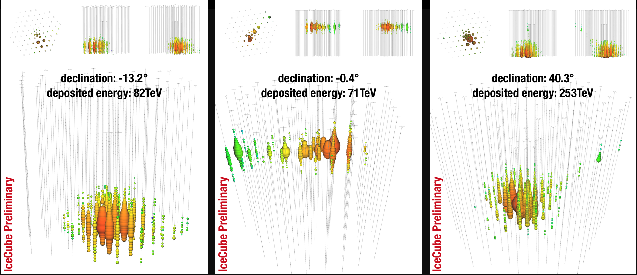
A Few Events

Slide 29
What Are They?

Slide 30
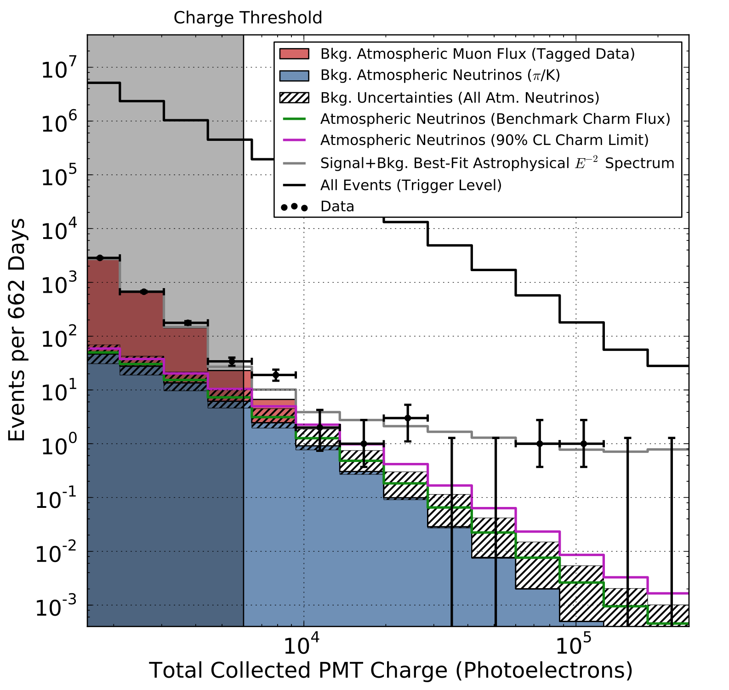
Charge (Brightness) Distribution
Fits well to background estimates below charge threshold
Hatched region: uncertainties in atmospheric neutrino flux
Significance of excess: 4.1σ
(P = 0.004%)

Slide 31
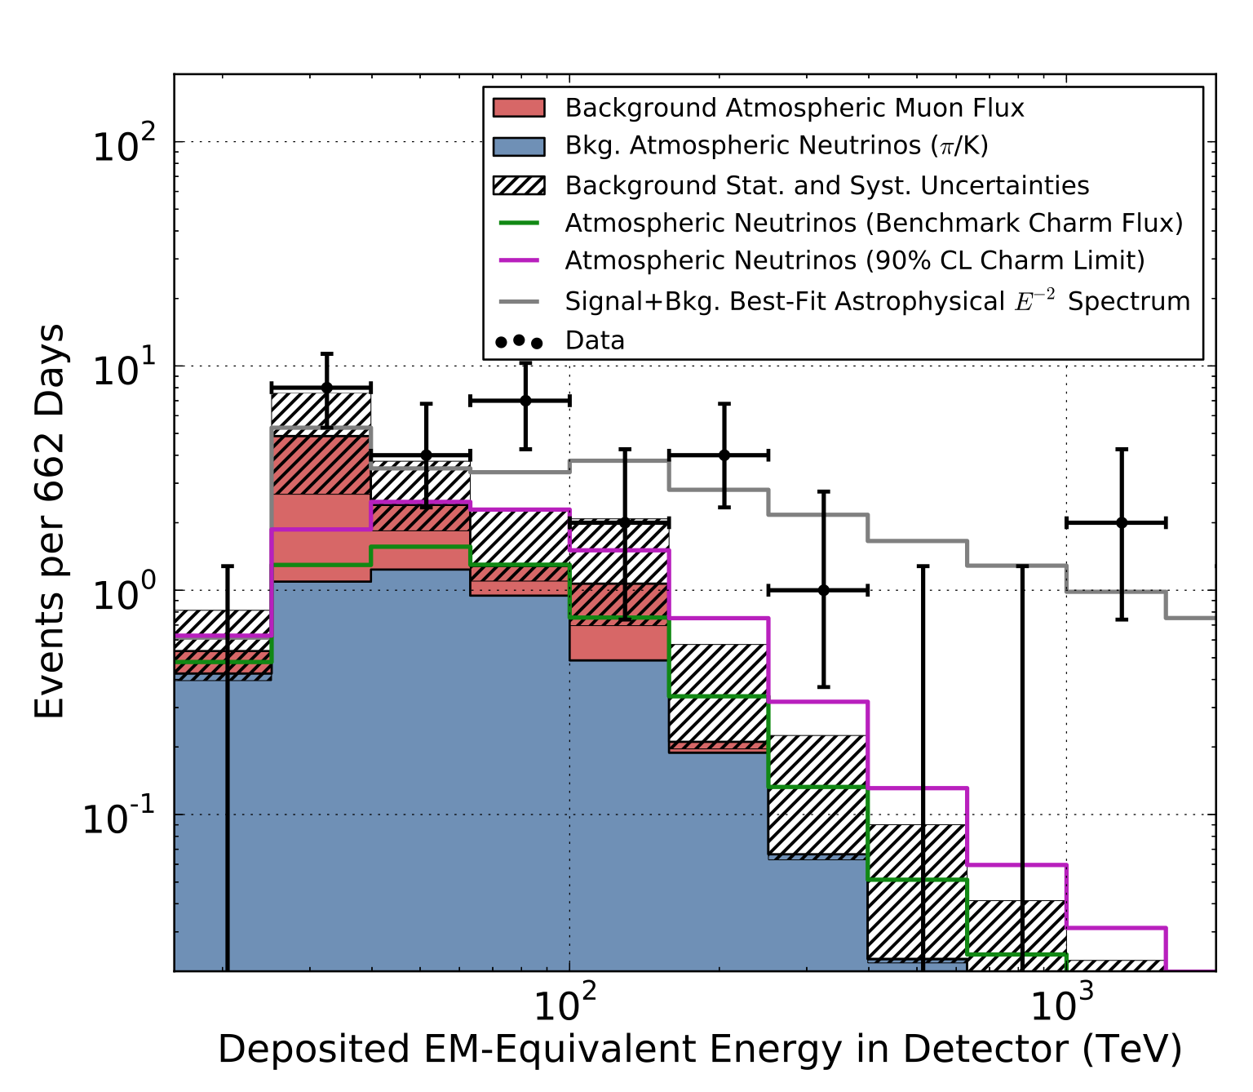
Deposited Energy Spectrum
Compatible with benchmark E⁻² astrophysical model
Potential cutoff at 2-5 PeV
Best-fit neutrino flux:
1.2±0.4×10⁻⁸
GeV cm⁻² s⁻¹ sr⁻¹

Slide 32
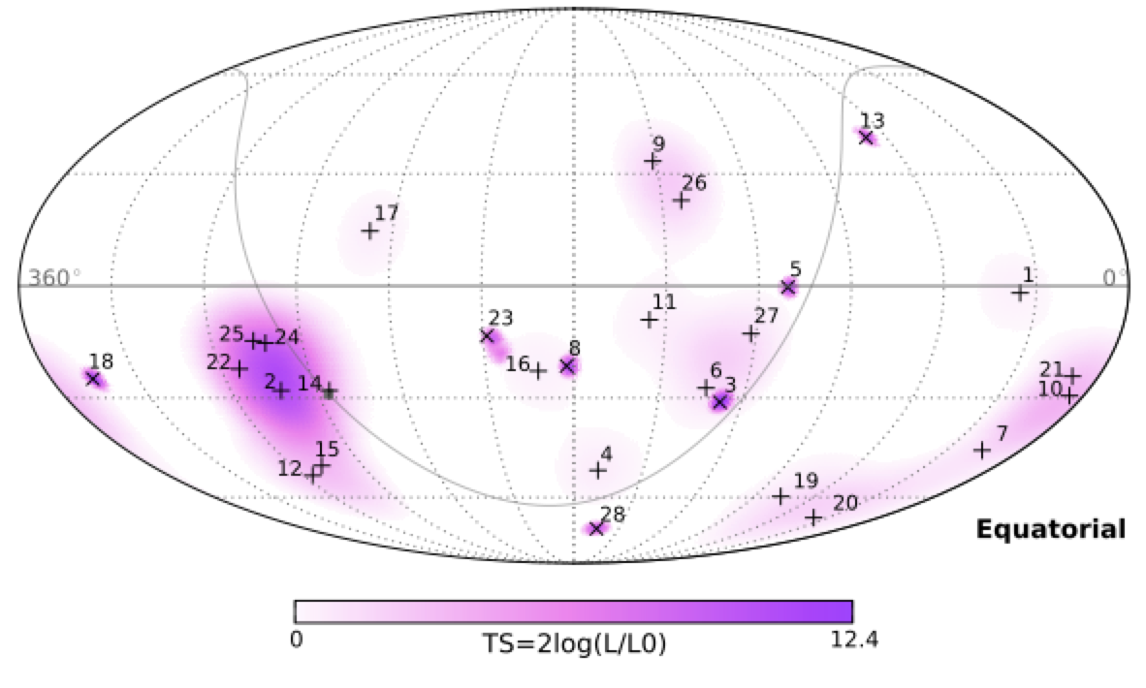
Skymap of the Event Directions (2013)
Skymap is compatible with a diffuse “glow” of high-energy cosmic neutrinos,
but we can’t say yet what the sources are

Slide 33
Update Skymap (2015)

Slide 34
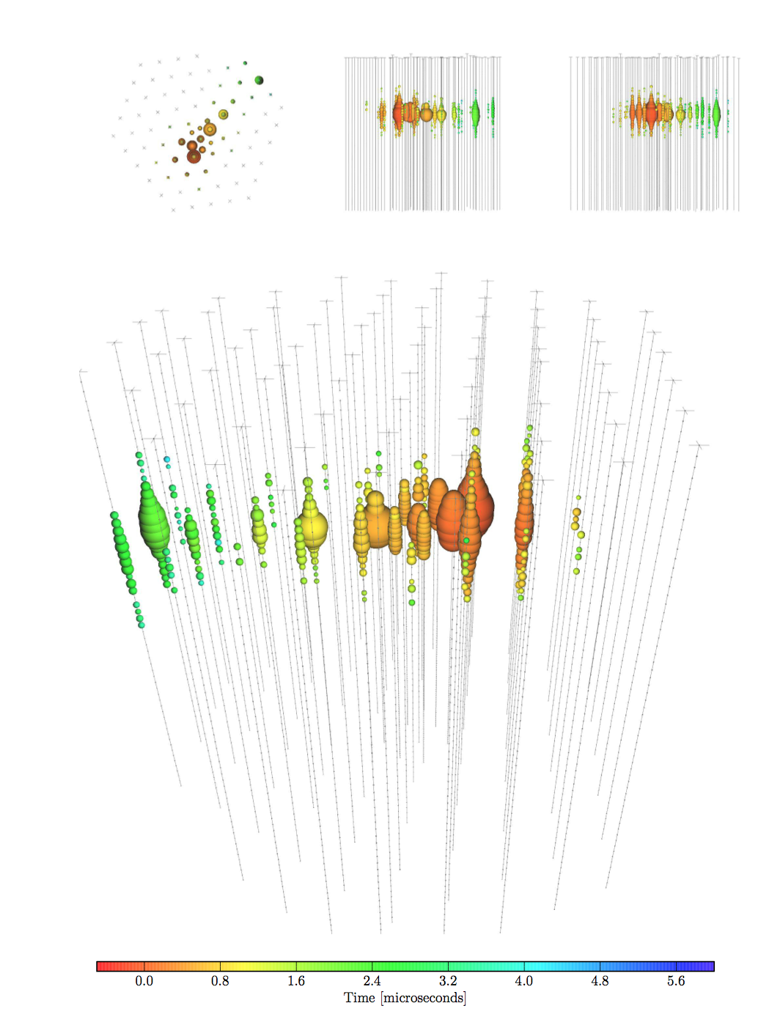
Why is this Interesting?
First observation of high-energy cosmic neutrinos
  only other astrophysical neutrinos observed from the Sun, SN1987A
We hope it is the beginning of neutrino astronomy
  find sources of cosmic rays (after 100 years!)
  understand the most violent objects in the Universe
  measure fundamental properties of neutrinos

Slide 35
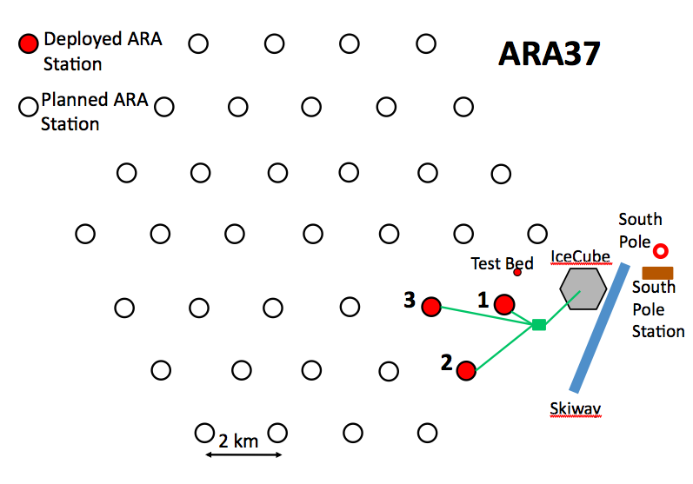
Other Neutrino Experiments at South Pole
ARA (Askaryan Radio Array): 200-km² ultra-high-energy neutrino detector
STATUS: testbed + 3 stations deployed; proposal to continue construction

Slide 36
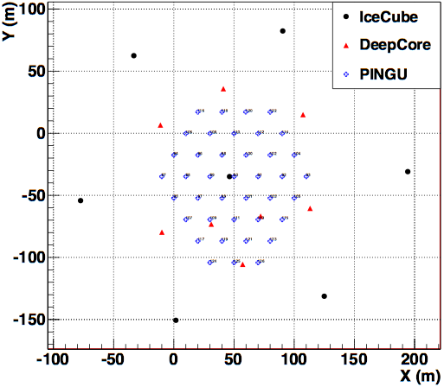
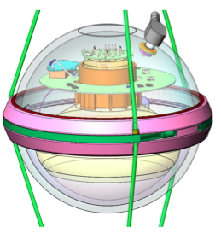
What’s Next?
PINGU: low-energy extension to determine neutrino mass hierarchy
40 strings
60 DOMs* per string
Bottom center of IceCube
  in-fills DeepCore
  in clearest ice
*PINGU Digital Optical Module: HQE PMT, electronics, pressure vessel, supporting hardware; very similar to IceCube DOM.
STATUS: Letter of Intent available; hardware prototyping

Slide 37
What’s After That?
IceCube high-energy array: next leap forward in neutrino astronomy
Y (m)
X (m)
STATUS: detector design simulations underway

Slide 38
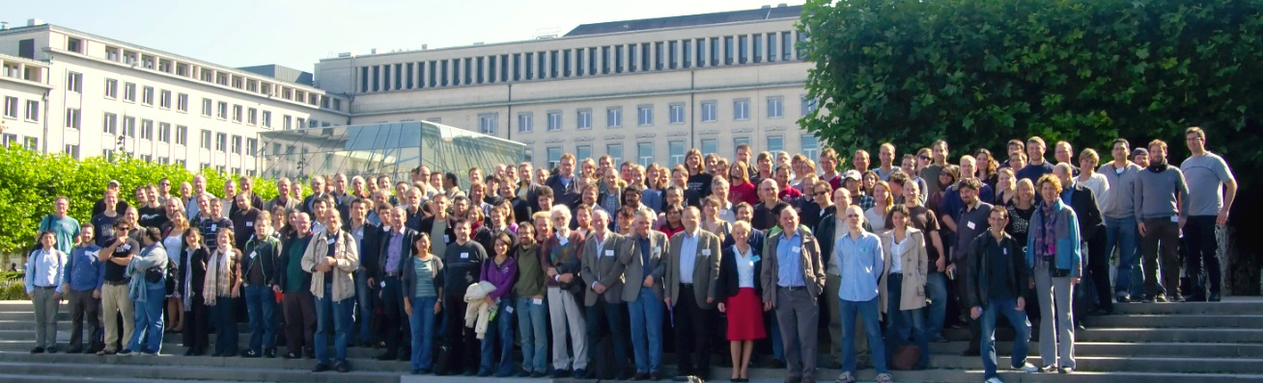



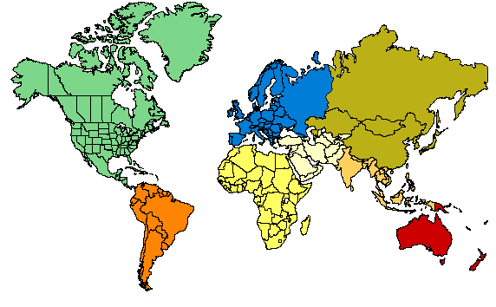






ICECUBE
COLLABORATION
10 countries, 40 institutions, ~260 collaborators
Universität Mainz, Germany
DESY Zeuthen, Germany
Universität Wuppertal, Germany
Universität Dortmund, Germany
Humboldt Universität, Germany
RWTH Aachen, Germany
Universität Bonn, Germany
Ruhr-Universität, Bochum, Germany
MPI, Heidelberg, Germany
Uppsala Universitet, Sweden
Stockholm Universitet, Sweden
Imperial College, London, UK
University of Oxford, UK
Université Libre de Bruxelles, Belgium
Vrije Universiteit Brussel, Belgium
Université de Mons, Belgium
Universiteit Gent, Belgium
EPFL, UniGe, Switzerland
Bartol Research Inst, Univ of Delaware, USA
University of Alaska Anchorage, USA
Pennsylvania State University, USA
University of Wisconsin-Madison, USA
University of Wisconsin-River Falls, USA
LBNL, Berkeley, USA
UC Berkeley, USA
UC Irvine, USA
Stony Brook University, USA
University of Alberta, Canada
Univ. of Alabama, USA
Clark-Atlanta University, USA
Georgia Tech
Ohio State University
Univ. of Maryland, USA
University of Kansas, USA
Southern Univ. and A&M College,
Baton Rouge, LA, USA
Chiba University, Japan
University of the West Indies, Barbados
University of Canterbury,
Christchurch, New Zealand

Slide 39
Backup Slides

Slide 40
Detector Performance
Simulated tracks
Simulated cascades
IC40
E⁻² spectrum
angular resolution: ~1º
energy resolution: ~35%
μ energy estimation via dE/dx
~30% in log₁₀(E)
angular resolution: ~10-30º
Continual time synchronization to ~2 ns; ice calibration with in-situ flashers

Slide 41
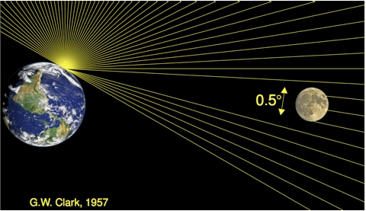
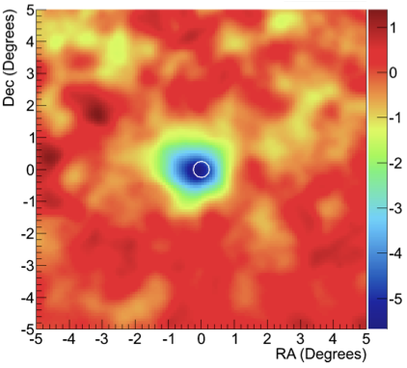
Shadow of the Moon

Slide 42
Cascade Directional Reconstruction

Slide 43
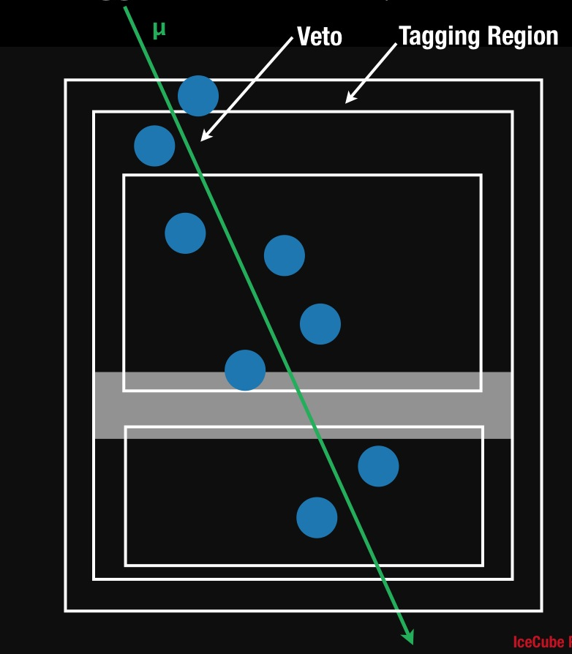
Muon Background Estimation From Data
Add one layer of DOMs to “tag” known background events
  use these to evaluate veto efficiency
Can be checked at lower energies where background dominates
Estimated muon background:
  3 ± 1.5 events / year
Remaining background is atmospheric neutrinos
  2.3 ^{+1.9}_{-0.6} events / year

Slide 44
IceCube Data Flow
~100 GB/day
DOMs
~1 TB/day

